Slide 1
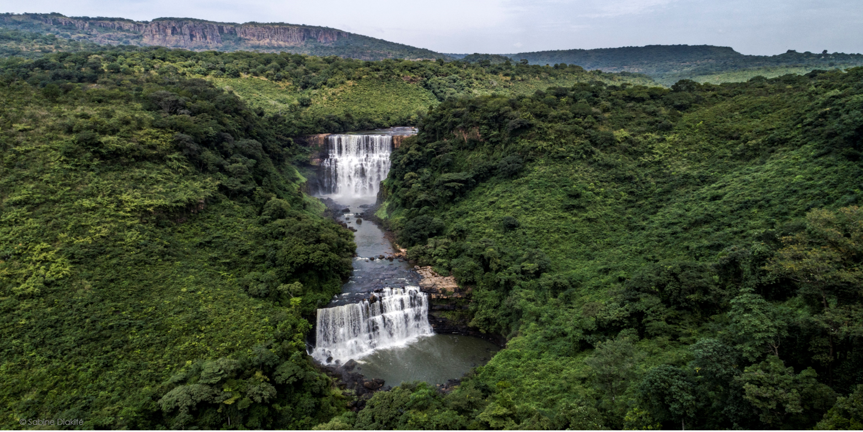

Invest in Tourism
Reinforce the attractiveness of the tourism sector

Slide 2
Plan
  General presentation
  Infrastructures
  Arts and culture
  Touristic sites
  Investment opportunities

Slide 3
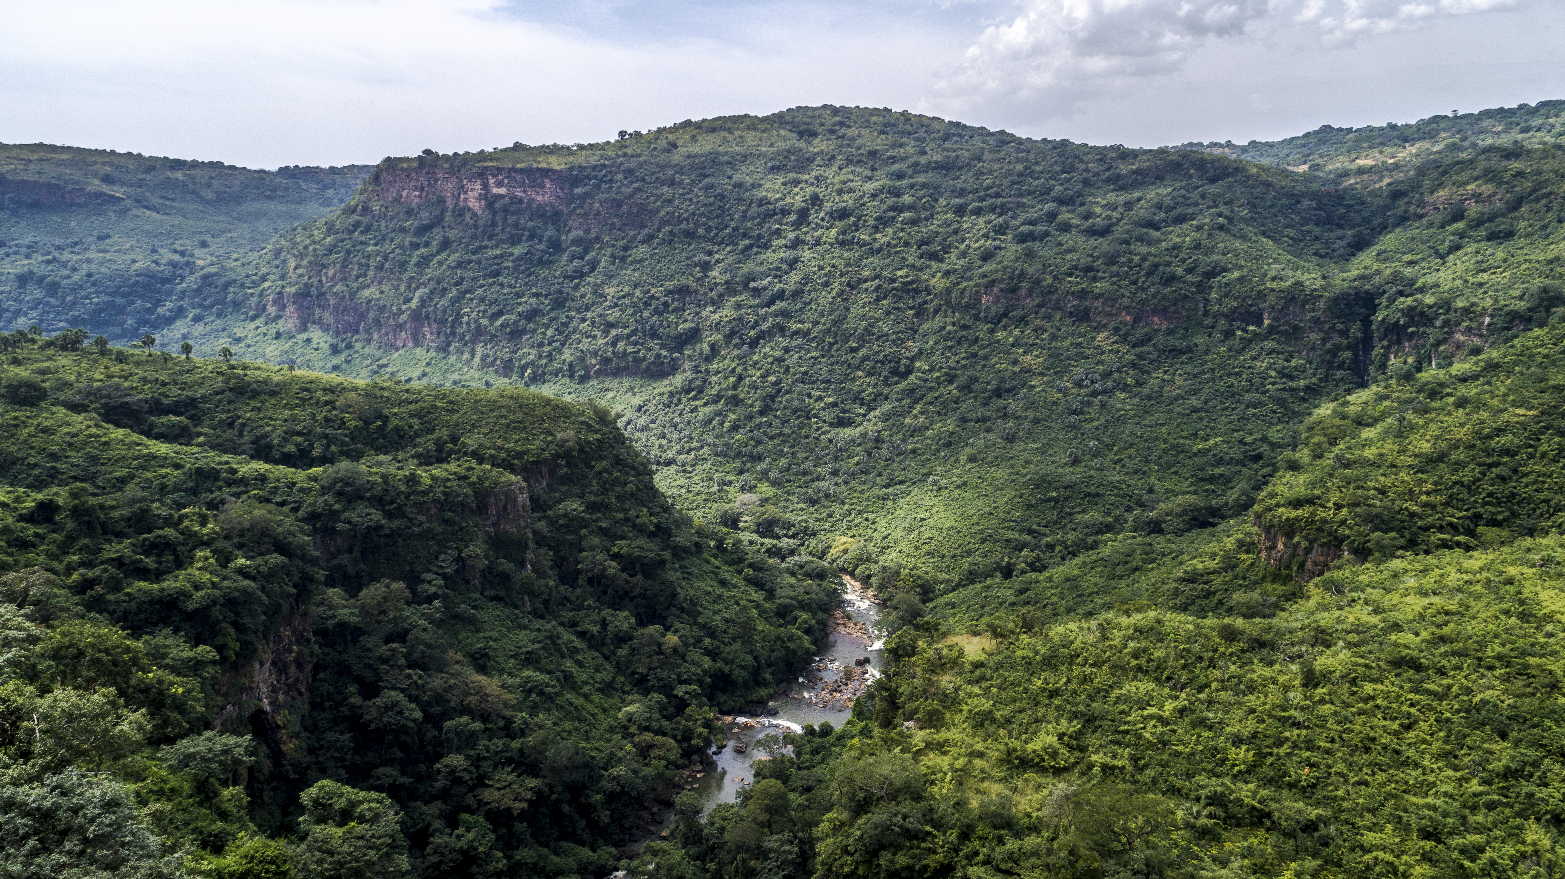
General presentation
3

Slide 4
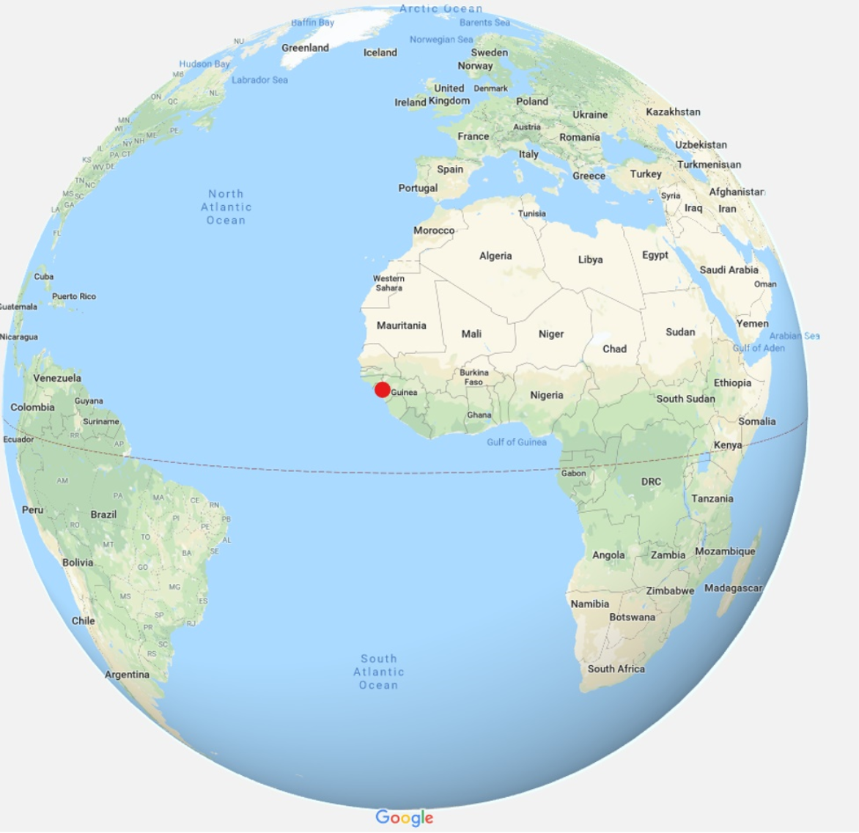
General presentation
Four natural regions:
  Lower Guinea
  Middle Guinea
  Upper Guinea
  Forest Guinea
Area: 245,857 Km²
Population: 12 million inhabitants
Tropical climate with 2 seasons:
  Dry season (November-May)
  Rainy season (June-October)
Coastline: more than 300 km of coast

Slide 5
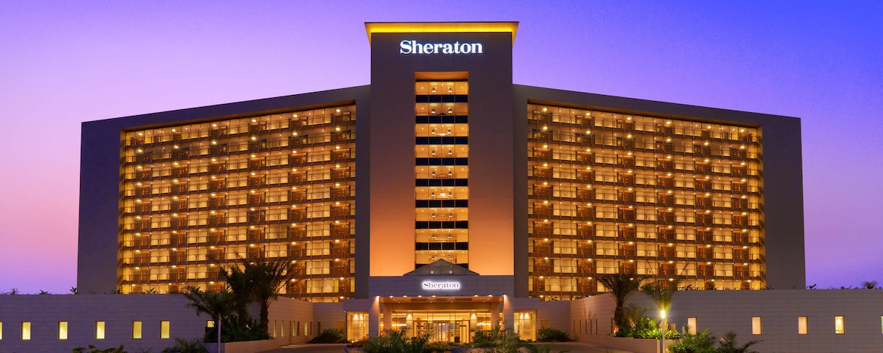
Infrastructures

Slide 6
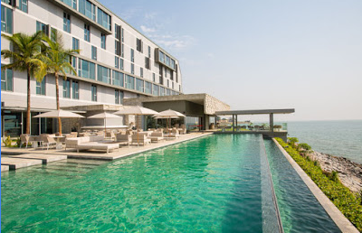
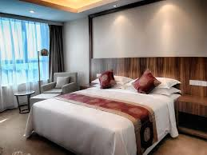
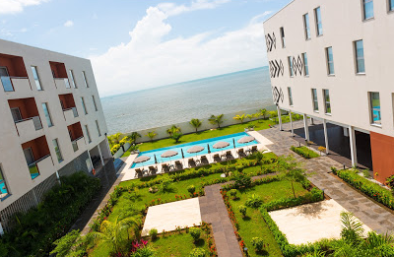
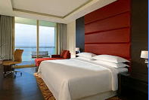
Infrastructures
Growing number of hotel infrastructures :
Construction and renovation of hotels
Better air service
Increase in the number
of tourists
12 airlines currently serve Conakry versus 9 in 2010:
Air France,
Brussels Airlines,
Royal Air Maroc,
Ethiopian Airlines,
Emirates,
Air Côte d’ivoire,
Turkish Airlines,
Asky,
Mauritania Airlines,
Tunisair
Transair
Air Senegal
150,000 tourists annually on average today versus only 46,000 prior to 2010
2,799 beds in Conakry in 2018 versus than 500 beds in 2010
Throughout the country, there are 6,795 hotel rooms versus 4,495 in 2010
2013: Palm Camayenne Hotel;
2014: Millenium Suites Hotel;
2016: Noom Hotel;
2016: Sheraton Grand Conakry Hotel;
2017: Onomo Hotel Conakry;
2018: Primus Kaloum Hotel;
Coming soon: Azalaï Hotel

Slide 7
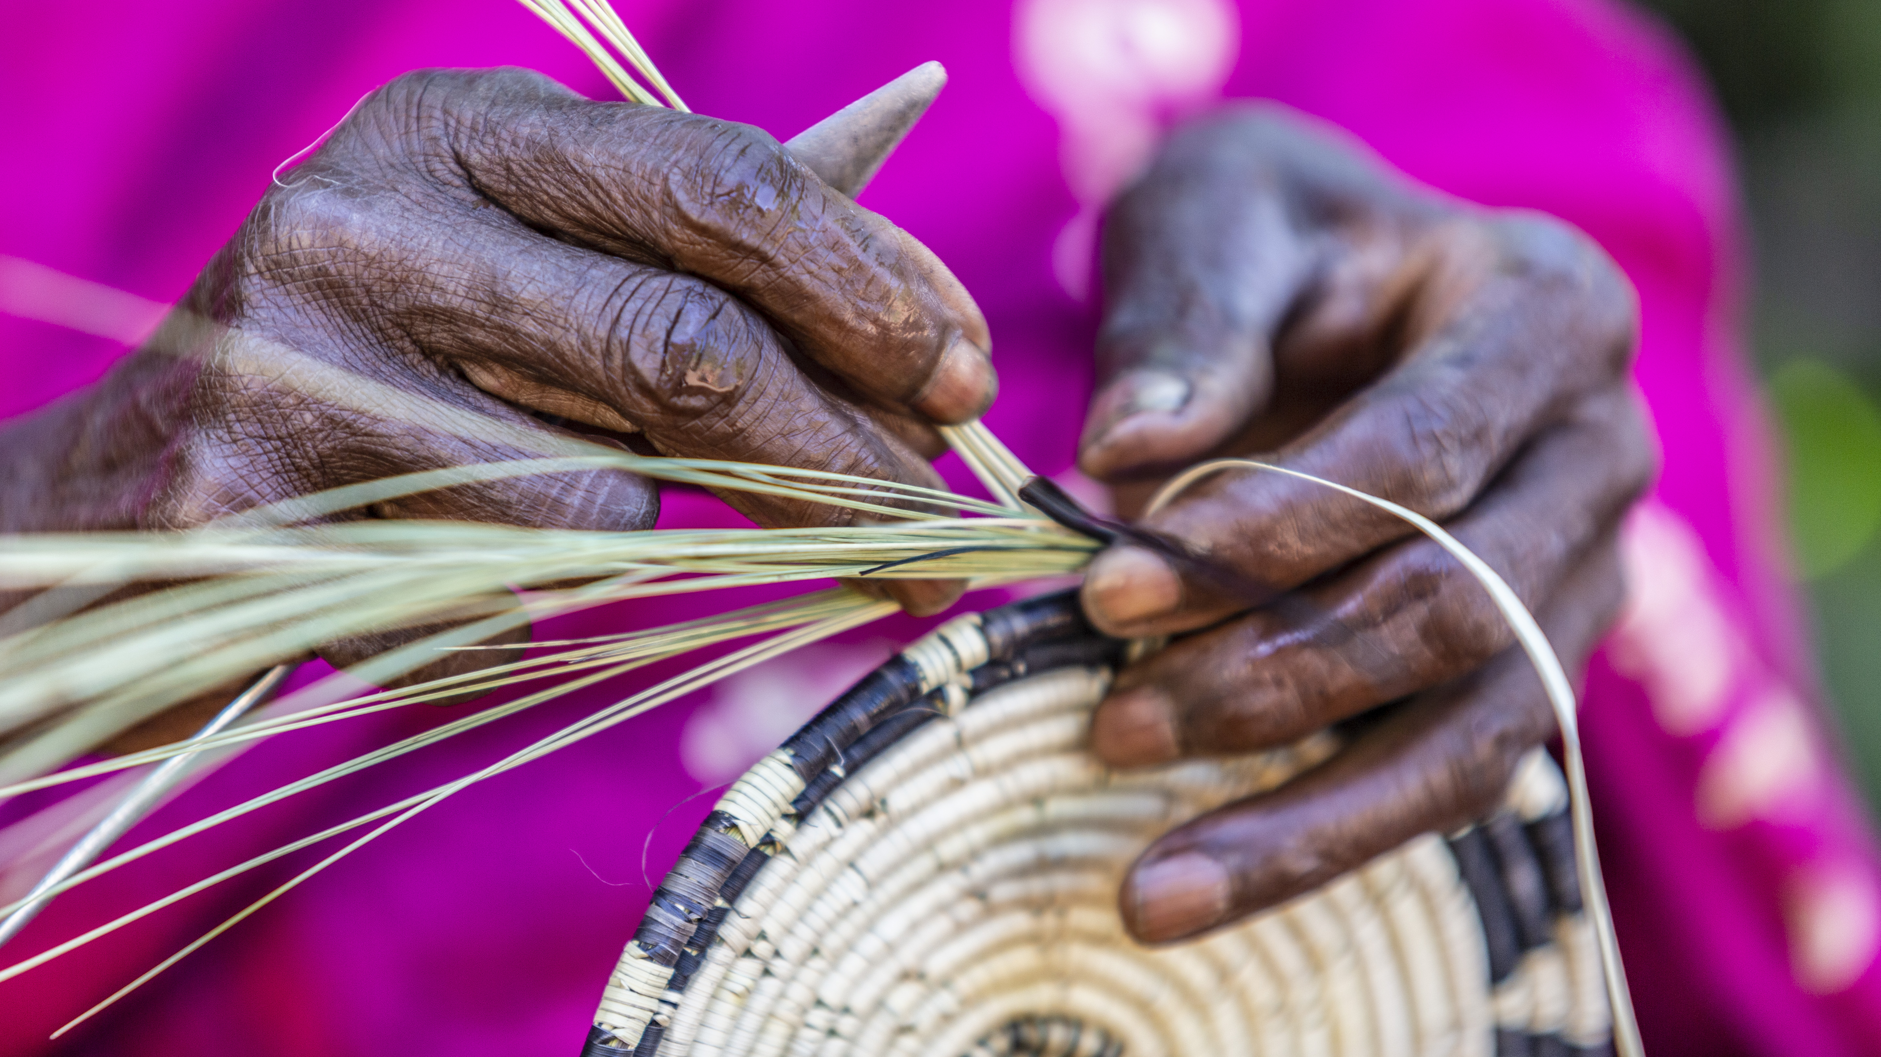
Arts & culture
7

Slide 8
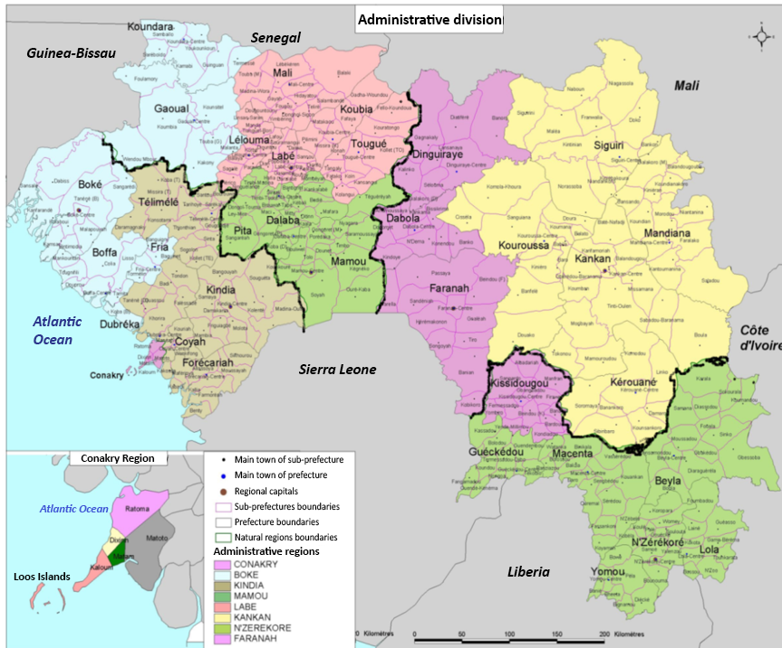
Arts & culture
4 diverse natural regions:
Middle Guinea
Lower Guinea: rites, dances and masks of Bagas, Landoumas.
Middle Guinea: rites, songs, dances and masks of Bassaris, Koniagui, Foulakoundas, Badiarankés and Fulani.
Upper Guinea: celebration of the Baro pond, rites, songs, dances and masks of Beredou, Hamana, Norassoba and Sankaran.
Forest Region: initiation ceremonies in the sacred forest
Upper Guinea
Lower Guinea
Forest Region
8

Slide 9
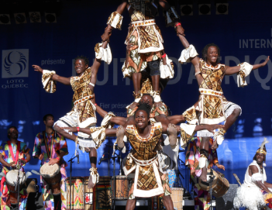
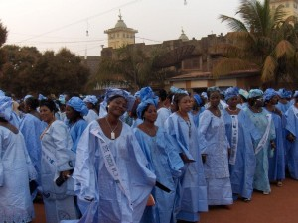
Arts & culture: music and dance
Famous "African Ballets" of Guinea.
Orchestras among the most prestigious of the continent such as the Bembeya Jazz National musical ensemble.
Djoliba National Ballet: traditional national symphonic ensemble of the late Sory Kandia Kouyaté.
Guinea percussion and acrobatic ensembles "Africa Oyé", "Baobab circus".
Traditional Kankan Mamaya dance organized every year after the Eid al-Adha festival.

Slide 10
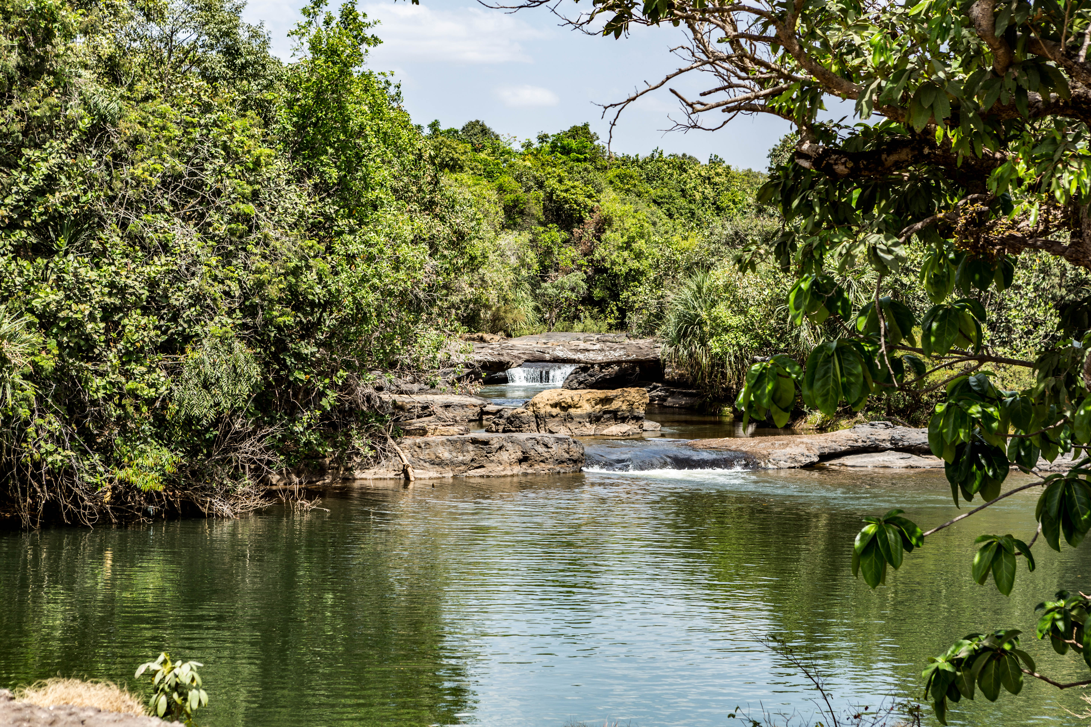
Touristic sites
10

Slide 11
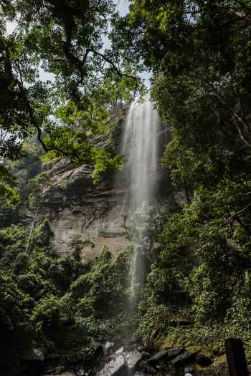
Touristic sites: wonders of nature
Discovery tourism:
  Dubréka (50 km from Conakry): the Soumba waterfalls
  Kindia (150 km from Conakry): the Bride’s Veil/Kilissi waterfalls
  Pita (396 km from Conakry): the gorges and waterfalls of Kinkon and Kambadaga
  Labé (431 km from Conakry): Saala Falls
  Mali (557 km from Conakry): the "Lady" of Mali
  Kérouané (835 km from Conakry): Kamarato Falls
Health tourism:
  Dalaba Station (325 km from Conakry)
  Hot springs in Foulamory (395 km from Conakry)
© Sabine Diakité

Slide 12
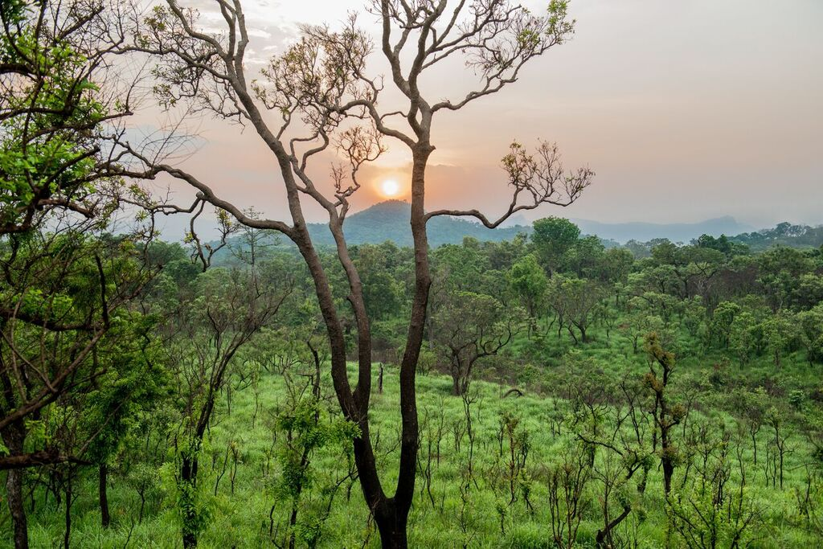
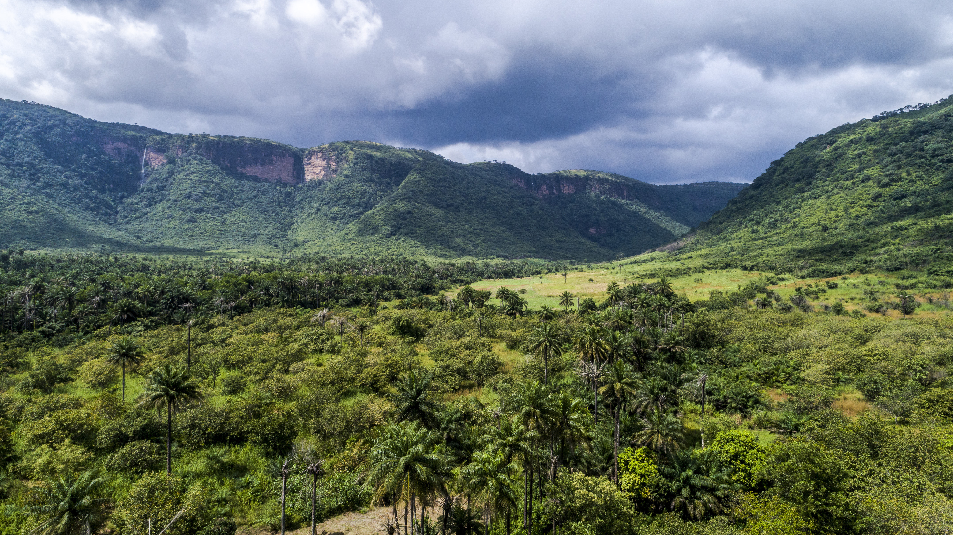
Touristic sites: natural diversity
Hiking Tourism
  Trekking : the mountainous region of Fouta
  The 30,000 ha Sangareya Bay in maritime Guinea consists of mudflats, birds, green islands and crocodile habitats.
  Mount Nimba and its surroundings: highest point of West Africa (1,752 m), the most beautiful forest of the subregion.
  The Ziama natural reserves and herds of elephants in Macenta.
Park and mountain tourism:
  Badiar park in Fouta (38,200 ha) with Sow hill, Mount Badiar and diverse game.
© Sabine Diakité

Slide 13
Tourist sites: entertainment
Seaside tourism: Lush green islands with splendid beaches: Sorro and Roume off the coast of Conakry, Sobane, Bel-Air, Kitikata and Marara in Boffa, Mèyèngbé in Dubréka and Salatougouj in Forécariah.
Park of Upper Niger: 1,860 km², crossed by the Niger River, rich in game (hippos, warthogs, fassa roosters, etc.), and lush flora.
© Sabine Diakité
Sport fishing in the Loos Islands: the most fished species are tarpon and barracudas.
Hunting tourism: small game with feathers and fur, and big game (warthogs, rhinos, antelopes, etc.)

Slide 14
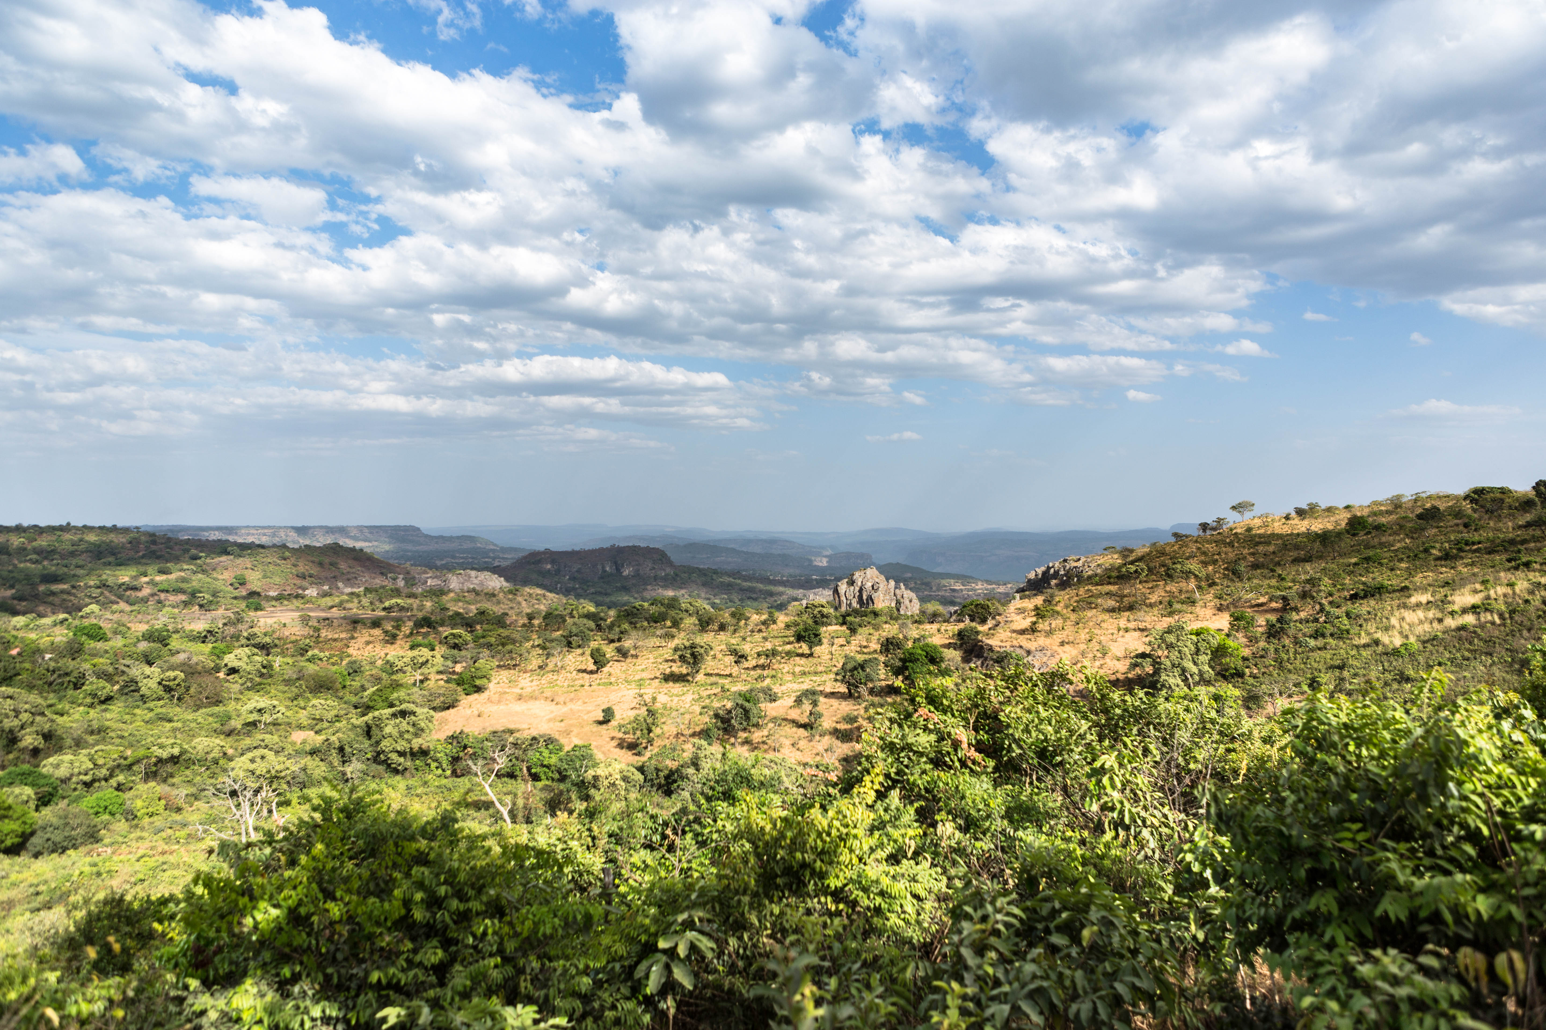
Investment opportunities
14

Slide 15
Sustainable tourism development project
Sustainable tourism development project in a network of transboundary parks and protected areas in West Africa.
The emphasis on tourism potential of Guinean parks and protected areas integrated in this network of transboundary parks will require the following funding:
Badiar Park: € 6,600,817
Falémé Park: € 10,268,681
Cogon-Cocoli-Nunez Park: € 3,484,785
Transversal activities (access roads, infrastructures, conservation and preservation of resources € 6,483,000
A total of € 26,837,283

Slide 16
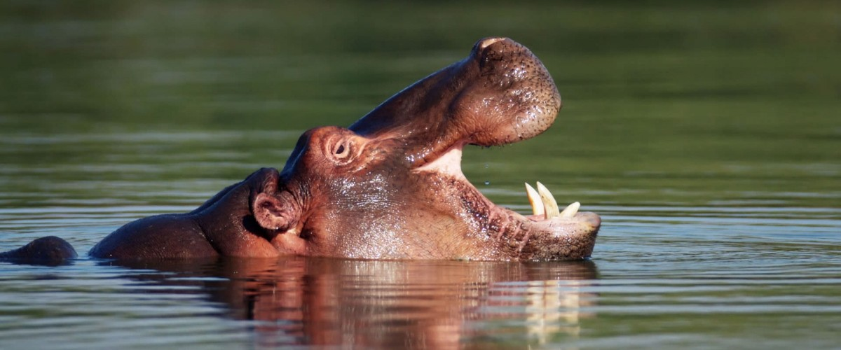
Project objectives:
Reduce poverty in local communities through increased income, job creation and promotion of income-generating activities.
Ensure the conservation of biological diversity at the subregional level.
Create a network of national and regional parks of transboundary protected areas.
Professionalize the tourism sector actors in the subregion, including local communities.
Promote sustainable tourism and ecotourism.
Support the process of subregional economic integration based on rational management of transboundary protected areas.
xxxx

Slide 17
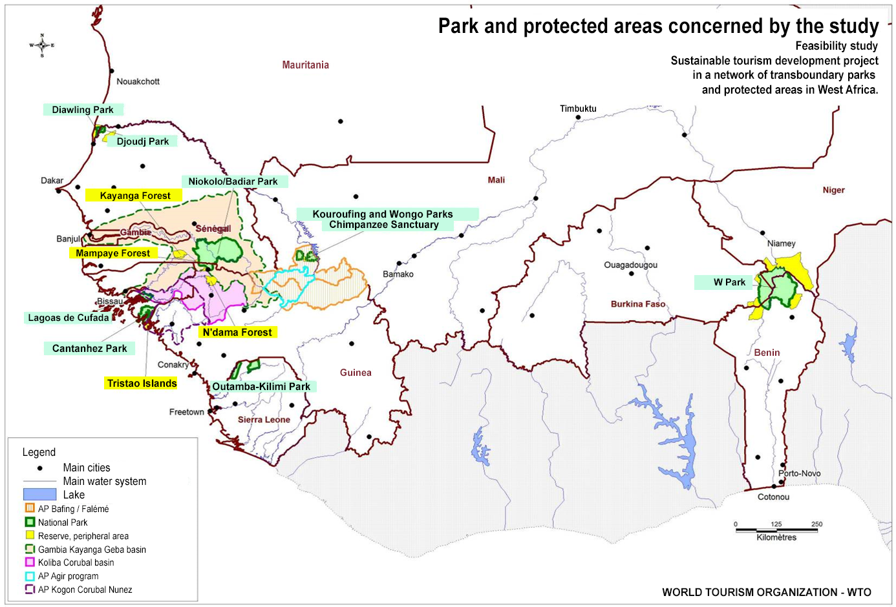
Protected parks and areas
xxxx

Slide 18
Tourism and handicrafts projects
NO. | PROJECT | COST | COMMENTS
1 | Studies for the construction of ecotouristic infrastructure “ecolodges”. | 1.5 million USD | T.O.R available
2 | Study for the development of Bel Air beach | 0.8 million USD | T.O.R available
3 | Study for the rehabilitation of the remains of Farinya in Boffa | 1.1 million USD | T.O.R available
4 | Study for the construction of the ports of call in Guinea | 1.48 million USD | T.O.R available
5 | Renovation of Niger de Faranah City | 22 million USD | T.O.R available
6 | Study for the development of Sorro beach | 0.87 million USD | T.D.R available (See O.N.T)
7 | Study for the construction of the tourist camp at Baro (Kouroussa) | 16 million USD | Ongoing studies (See O.N.T & D.A.F)
8 | Creation of an Artisanal Pilot center in Conakry | 6.550.000 USD | Preliminary project studies completed and site to be identified
9 | Construction of 3 craft villages in the main towns of the administrative regions of Kindia, Labé and the prefecture of Lola | 40 million USD | D.A.O available
10 | Feasibility studies for the construction of craft villages in the main towns of the administrative regions of Boké, Mamou, Kankan and Kissidougou prefecture | 1.25 million USD | See D.N.A

Slide 19
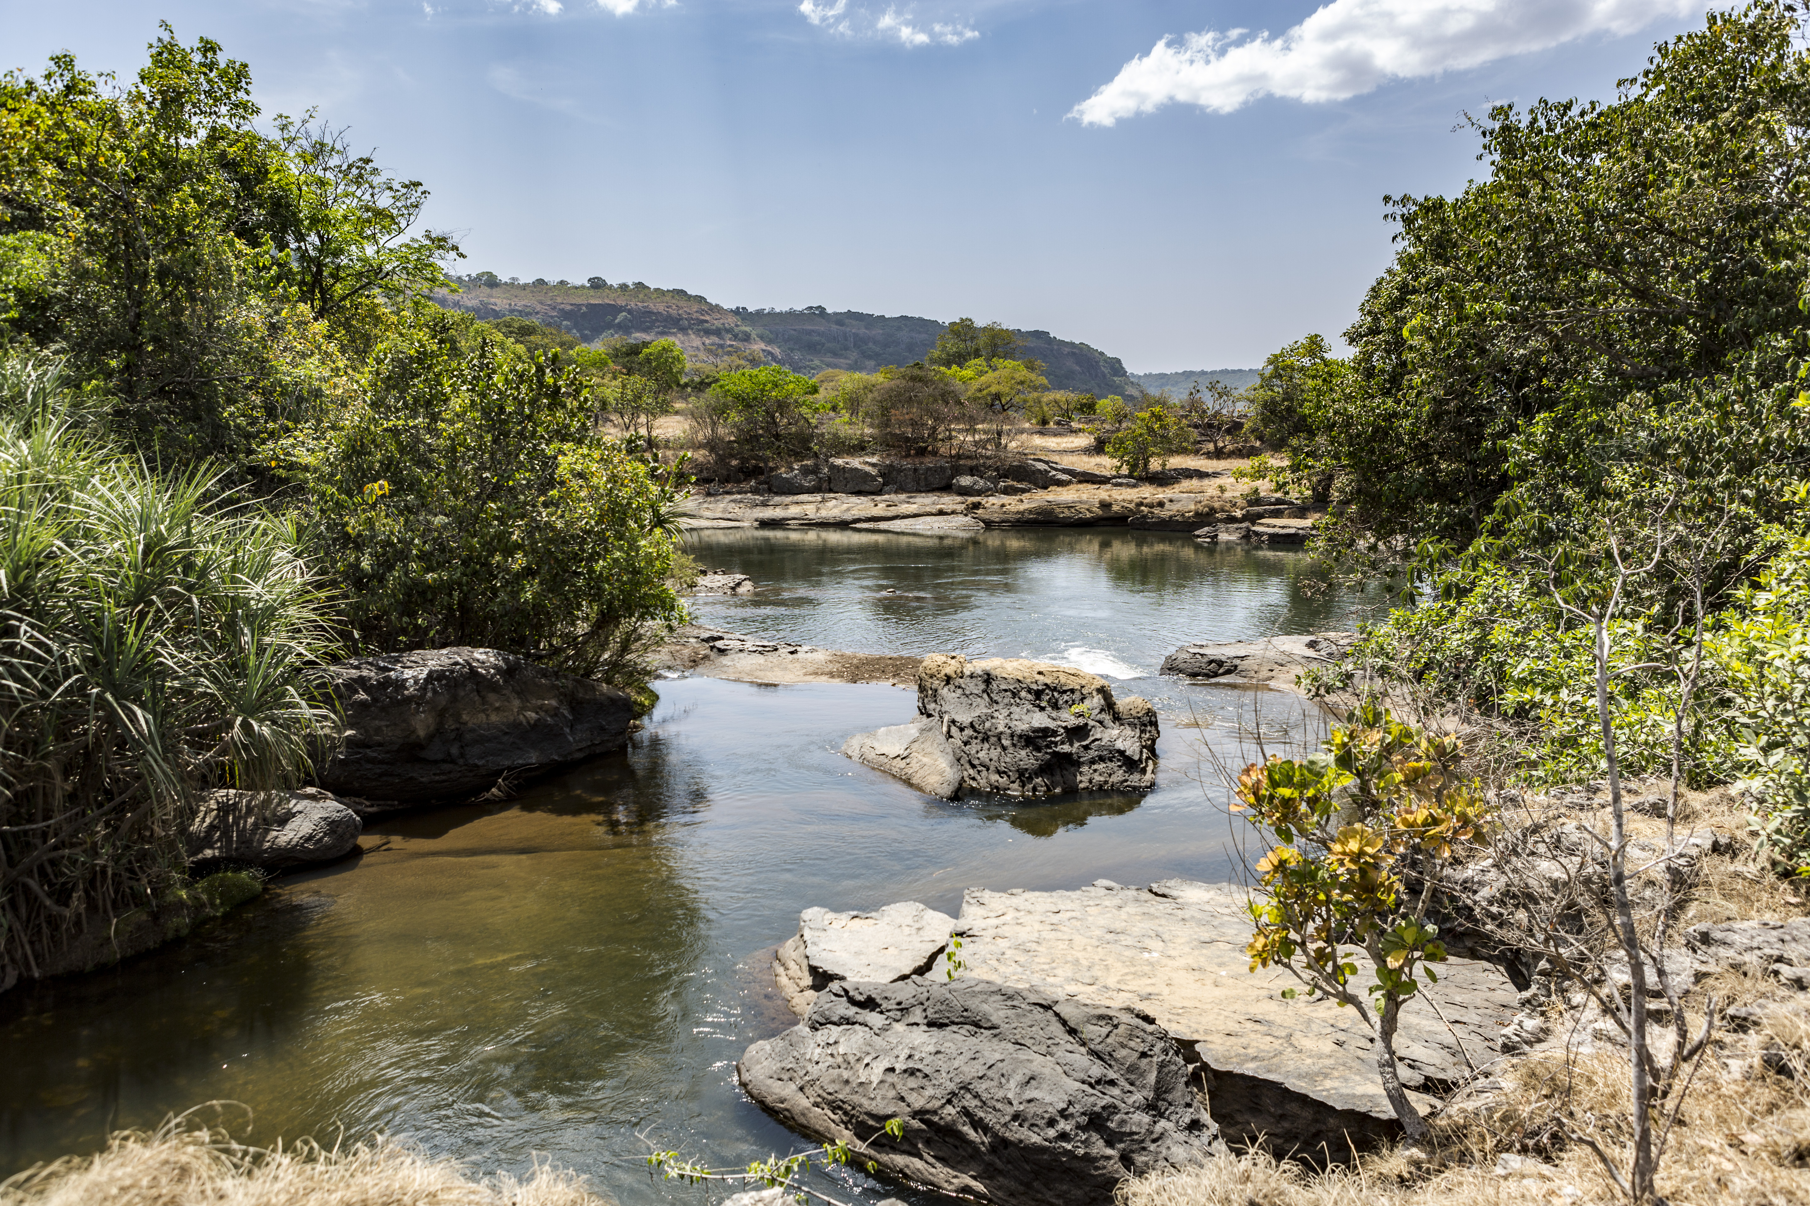
Thank you for your attention
Insert Image
www.invest.gov.gn

