Slide 1


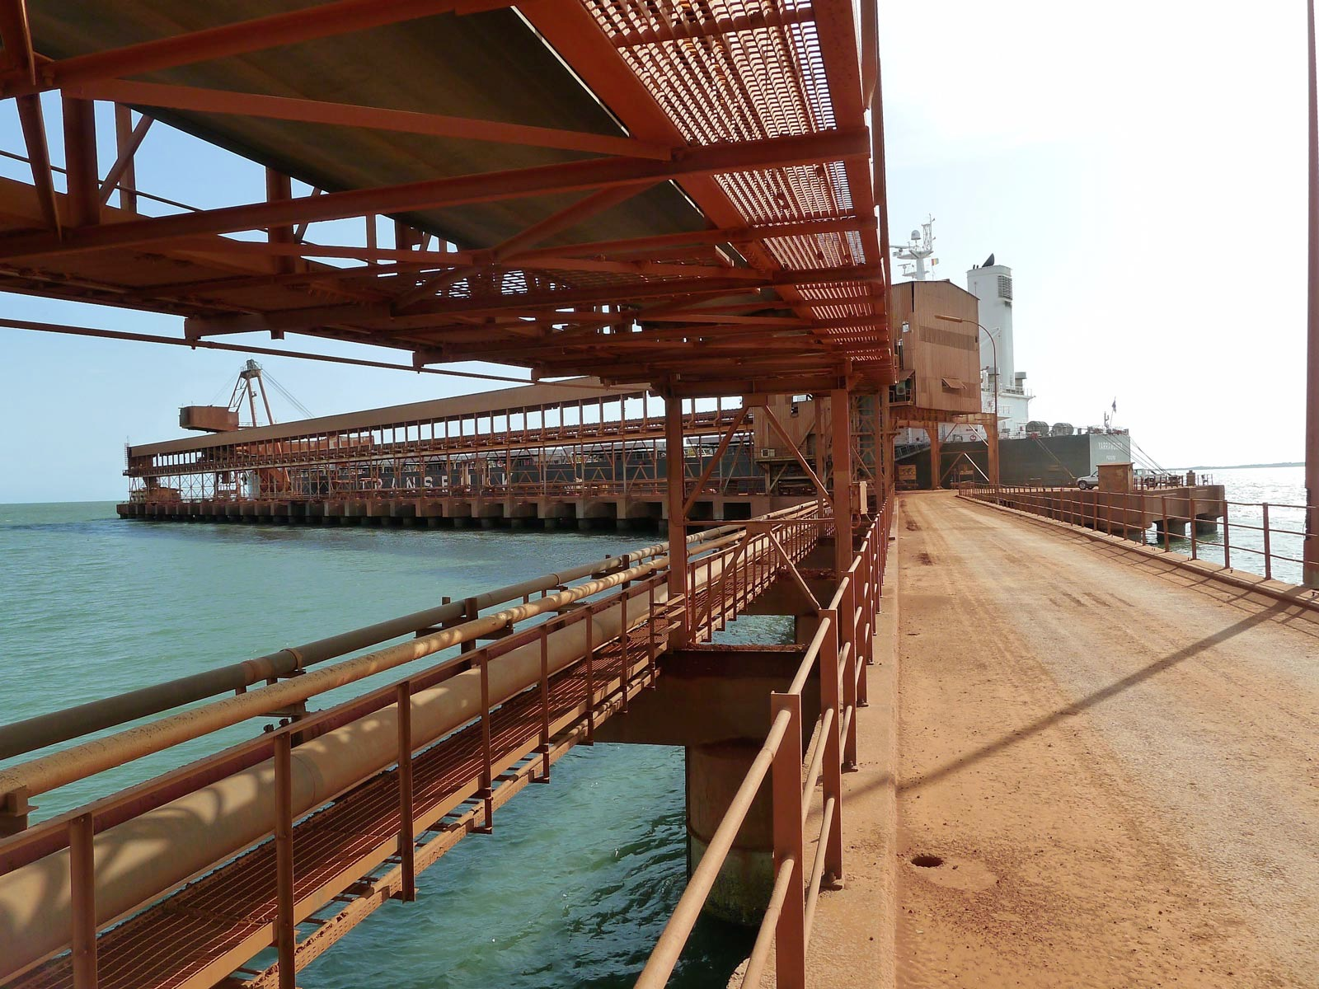
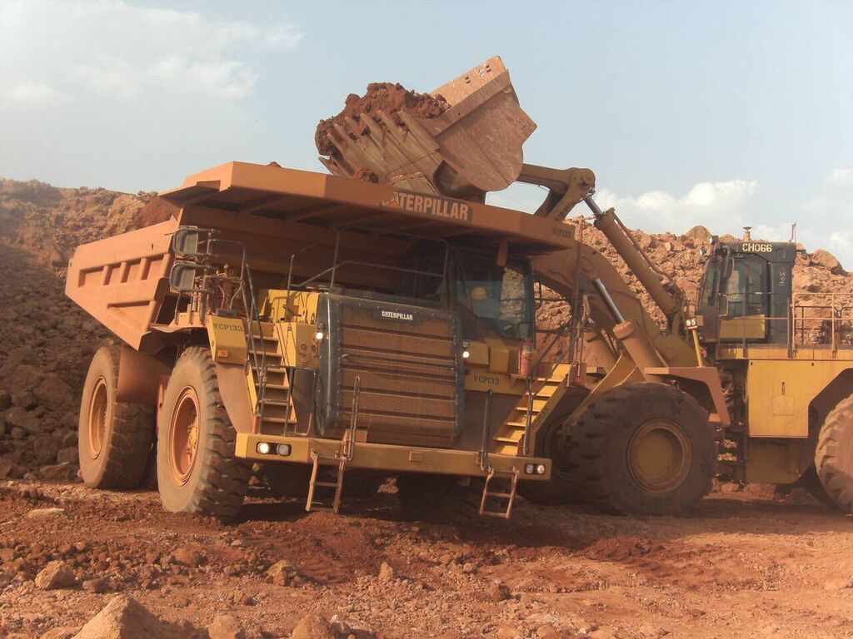
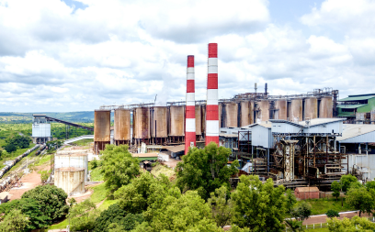
GUINEA: A TOP MINING DESTINATION
Ministry of Mines and Geology
Republic of Guinea
September 2019

Slide 2

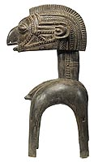
SUMMARY
Overview of Guinea’s mineral potential
Main reforms
Unprecedented mining investments
Beyond mining opportunities
Strengthening the national economy
Challenges

Slide 3
Overview of Guinea’s mineral potential
World class deposits

Slide 4
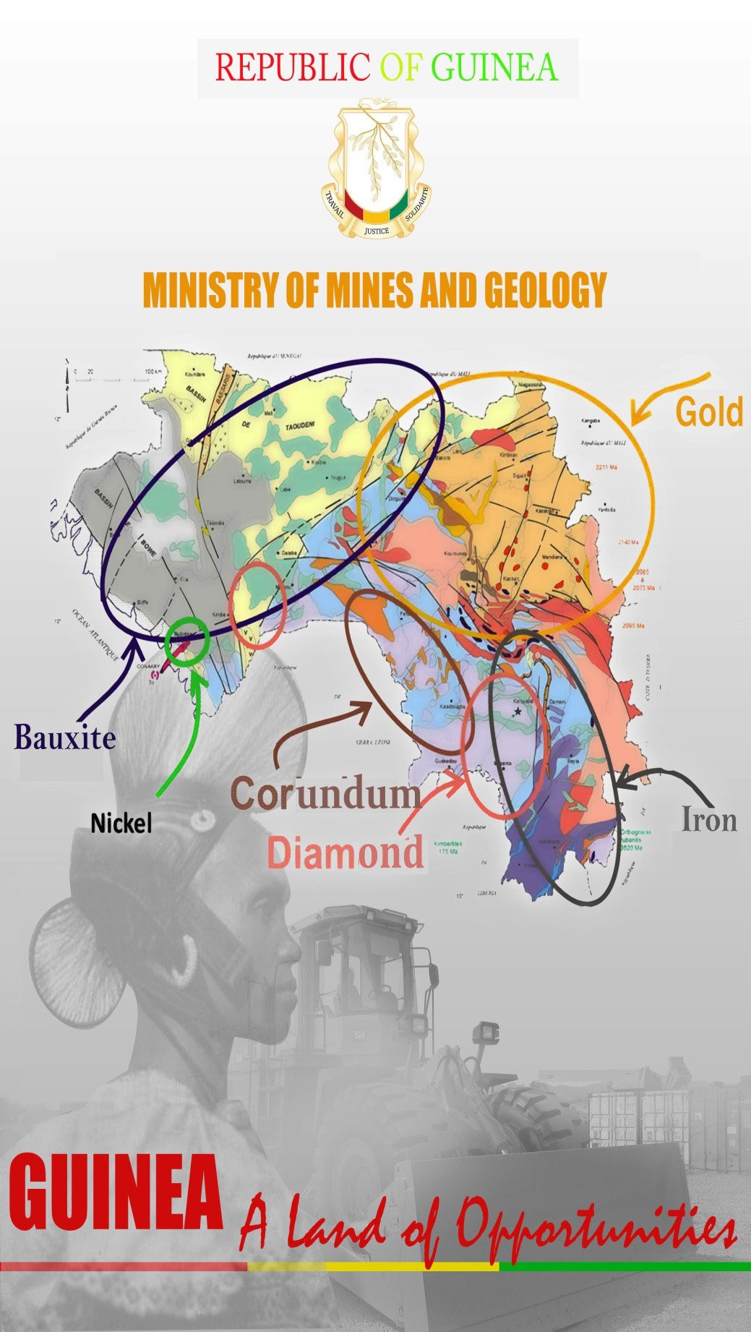
1. OVERVIEW OF GUINEA’S MINERAL POTENTIAL
A large Potential to Unlock. World-class Deposits

Slide 5
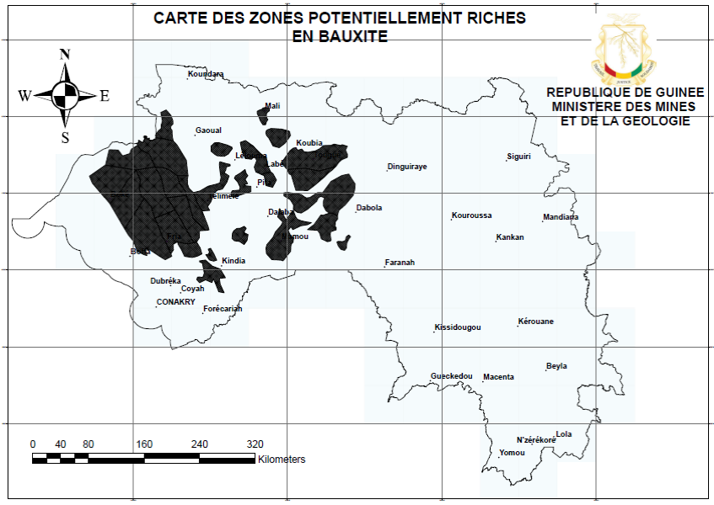
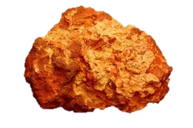

1. OVERVIEW OF GUINEA’S MINERAL POTENTIAL
BAUXITE
Guinea holds the world’s largest deposits; resources are estimated to be 40 billion tons, with a grade higher than 40%;
Bauxite deposits do not require complex extraction techniques; extraction costs are relatively low.

Slide 6
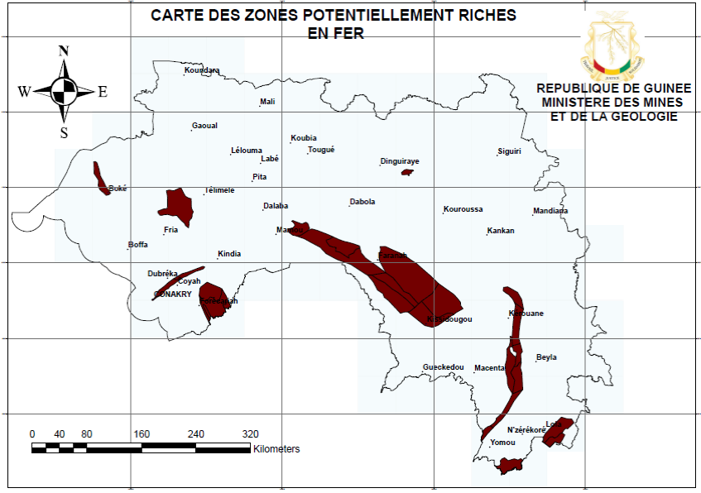
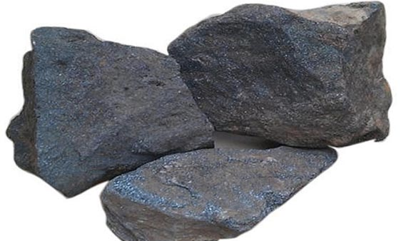
1. OVERVIEW OF GUINEA’S MINERAL POTENTIAL
IRON ORE
Guinea has the largest and best untapped iron ore deposits in the world; 20 billion tons of the world-class reserves (high grade: more than 60%): Simandou, Nimba, Zogota, etc.

Slide 7
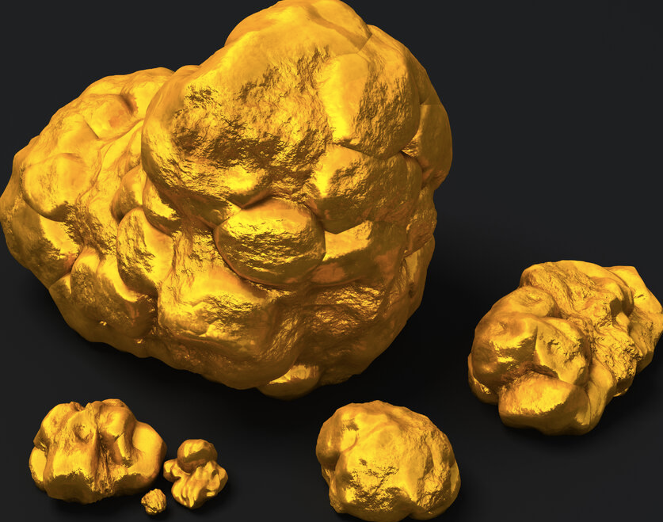
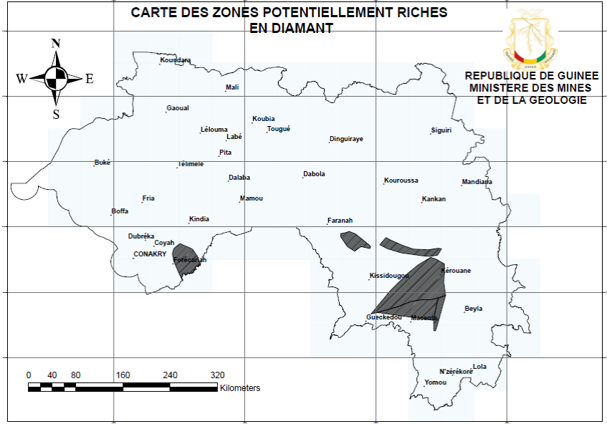
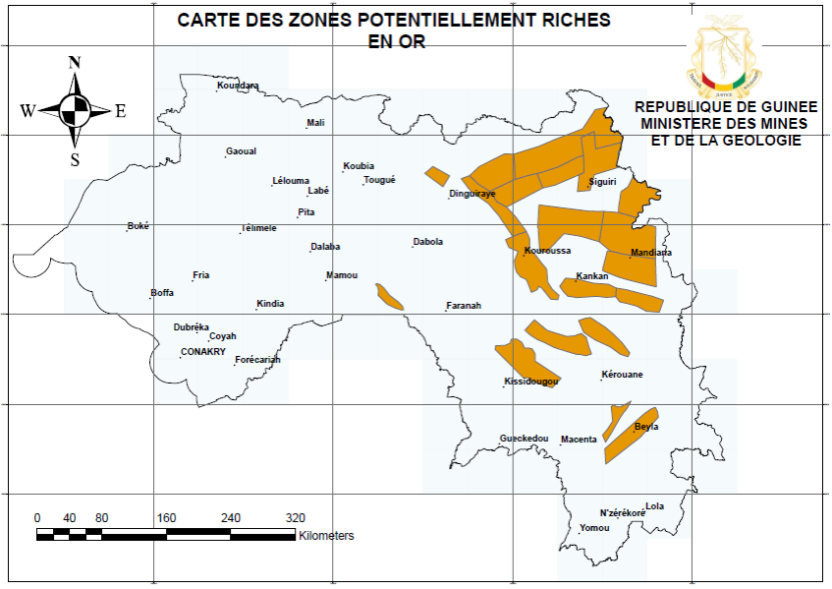
1. OVERVIEW OF GUINEA’S MINERAL POTENTIAL
GOLD & DIAMOND
30 million carats and more than 700t of gold;
Primary and Secondary Deposits
The Birimian gold belt and the diamond triangle have yet to unlock their full potential

Slide 8
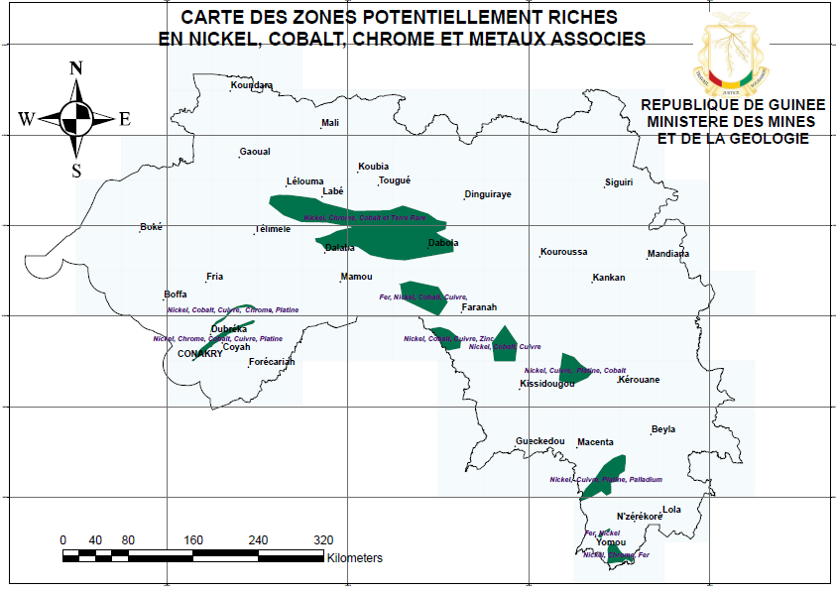
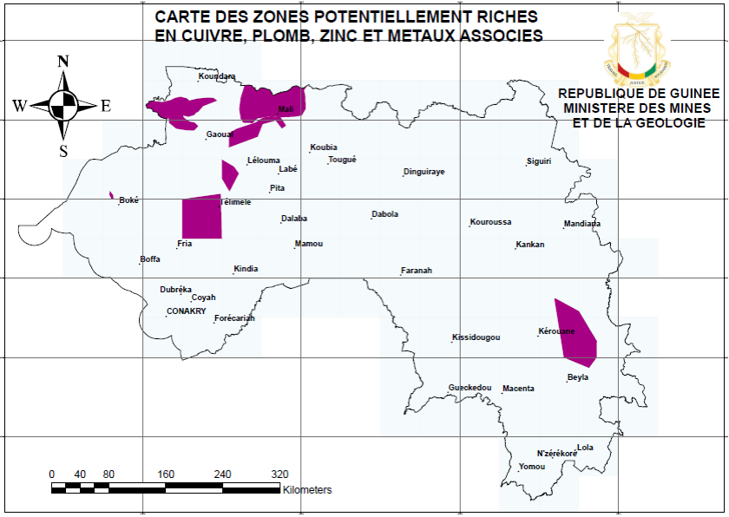
1. OVERVIEW OF GUINEA’S MINERAL POTENTIAL
BASE METALS
Nickel, Cobalt, Copper, Lead, Zinc, Chromium and related metals.
Prospective zones in the Kakoulima mountains, Koundara, Boffa, Kissidougou-Faranah…

Slide 9
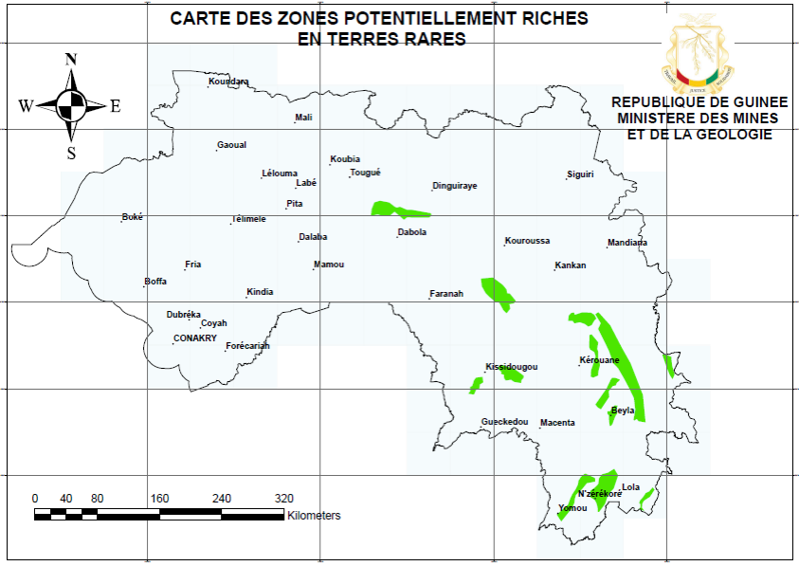
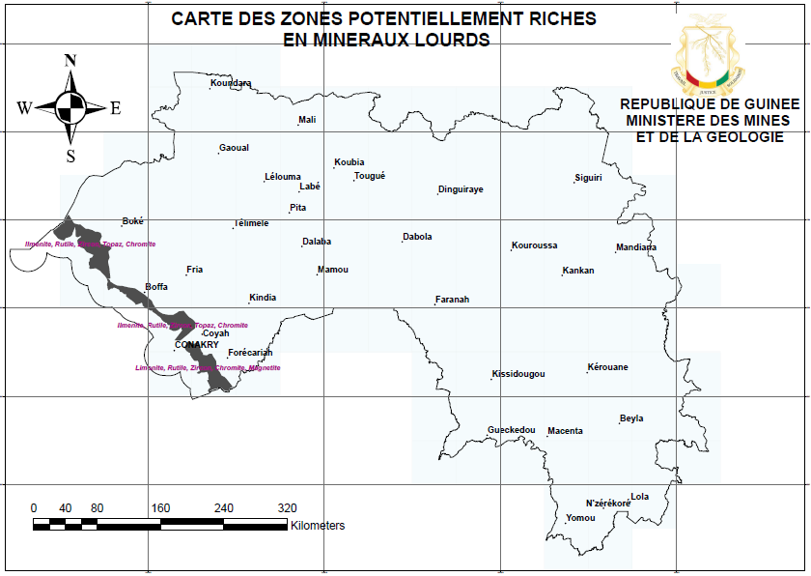
1. OVERVIEW OF GUINEA’S MINERAL POTENTIAL
RARE EARTH & HEAVY MINERALS
Major occurrences of rare earths found by geologists in many areas of Guinea particularly in Macenta, Kissidougou and Kérouané;
Tremendous mineral sands potential on the costal line: Ilmenite, rutile, zircon…

Slide 10
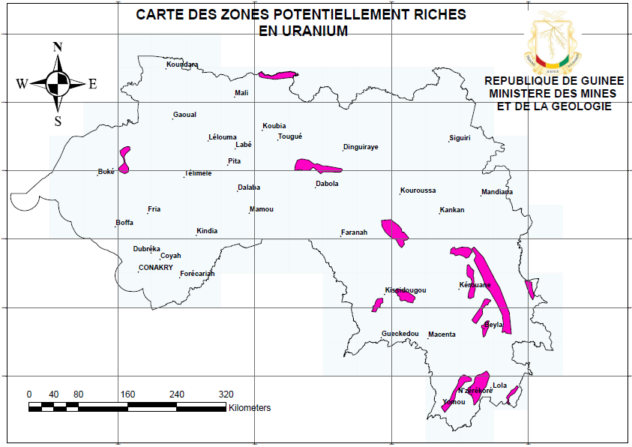
1. OVERVIEW OF GUINEA’S MINERAL POTENTIAL
URANIUM
Many areas with very good prospects for uranium mineralization : Kissidougou, Kérouané, Dabola, N’Zérékoré, Lola.

Slide 11
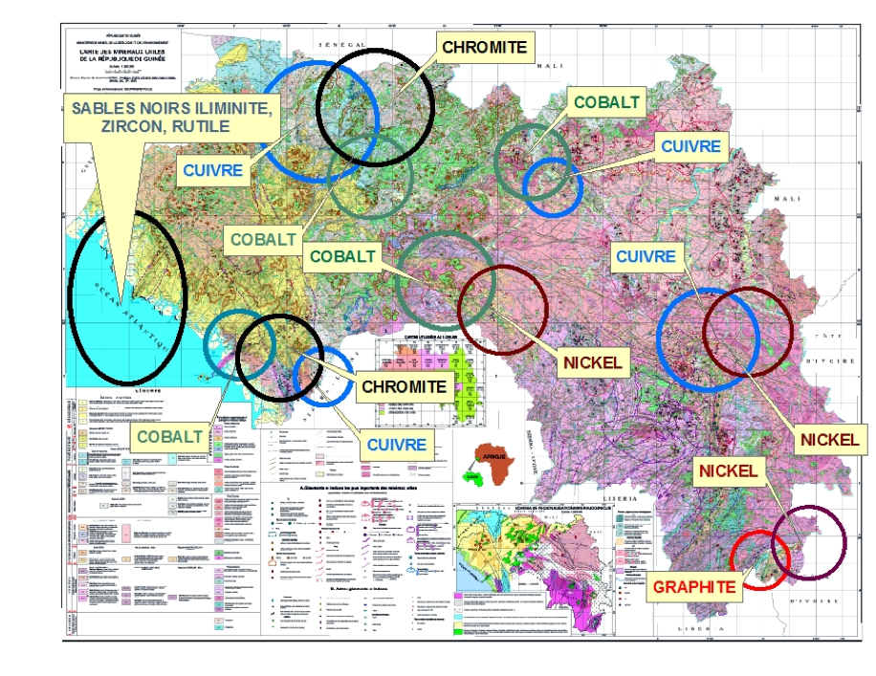
1. OVERVIEW OF GUINEA’S MINERAL POTENTIAL
OTHER RESOURCES

Slide 12
2. Main reforms
One of the top reformers in Africa

Slide 13
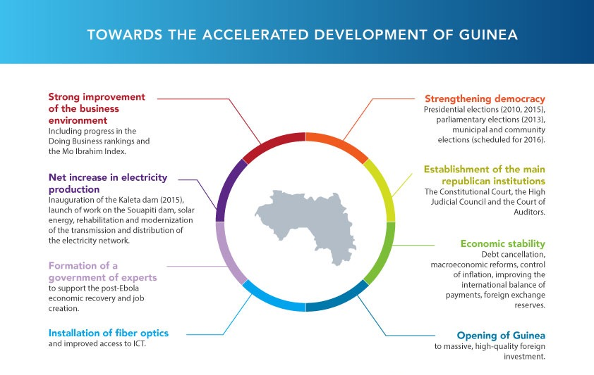
2 . MAIN REFORMS

Slide 14

2 . MAIN REFORMS
Since the election of President Alpha CONDE in 2010, unprecedented reforms have made Guinea one of the best destinations for mining investments in Africa:
Adoption of the new mining code in 2011 and amended in 2013 with incentives for investment, guarantees the state’s mineral revenues and incorporates important innovations including environmental protection and anti-corruption measures
Adoption in 2014 of a shared use of mine related infrastructure policy with a master plan for mining ancillary infrastructures
Creation in 2016 of a One-stop Shop to facilitate and speed up administrative procedures for obtaining permits and authorizations for integrated mining projects
Modernization of the Mining Cadastre (www.guinee.cadastreminier.org)
Compliance to the Extractive Industries Transparency Initiative since 2014
Adoption in 2017 of a Corporate Social Responsibility (including environmental, social, financial, HSE aspects) and Local Content Policy

Slide 15
3. Unprecedented mining investments
A regional leader

Slide 16
3. UNPRECEDENTED MINING INVESTMENTS
A rapidly changing mining sector
Since 2011, over $3.6 billion USD have been invested in mining. In addition, more than $7 billion USD are expected to be invested by 2025.
Substantial increase in bauxite production (from 18 million tons in 2010 to 60 million tons in 2018)
making Guinea the 3rd largest bauxite in the world
Over 17 000 direct jobs, and 50 000 indirect jobs have been created
11 active industrial mining operations in 2018 compared to 6 in 2010
New corridors along new railway projects are being developed in previously landlocked areas.
Guinea ranked among to top five reformers in the world (World Bank) in 2017

Slide 17

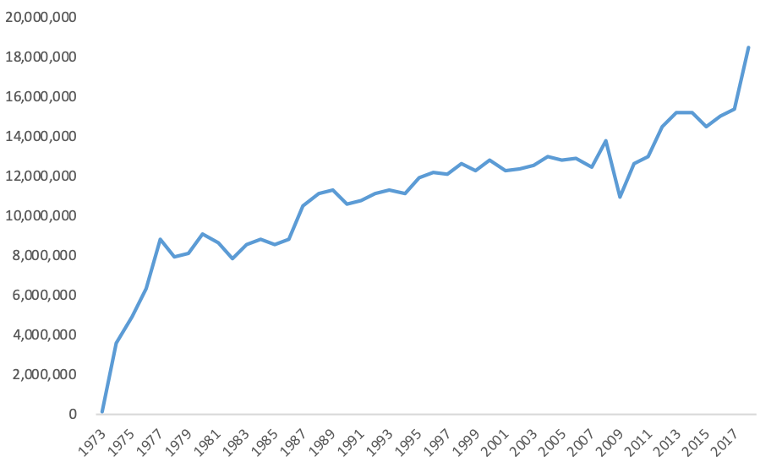

3. UNPRECEDENTED MINING INVESTMENTS
Guinea and Alcoa, a win-win relationship of more than 40 years
CBG has consistently delivered stable and improving sales volumes throughout Guinea’s history.
GoG with his American partner ALCOA shows an impressive track record since its first production, 40 years ago

Slide 18

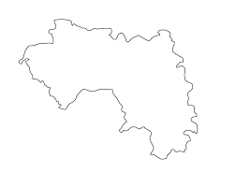
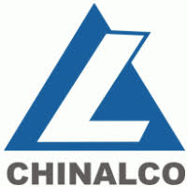



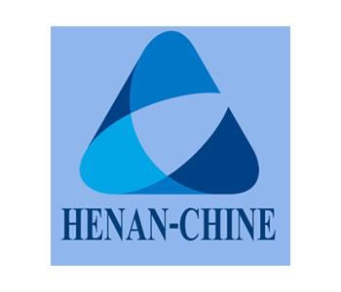












3. UNPRECEDENTED MINING INVESTMENTS
Current projects
US$ 535 million
US$ 200 million
US$ 3 billion
US$ 300 million
US$ 240 million
$120 million
US$ 643 million
US$ 150 million
US$ 3 billion
US$ 1 billion
US$ 1.4 billion

Slide 19

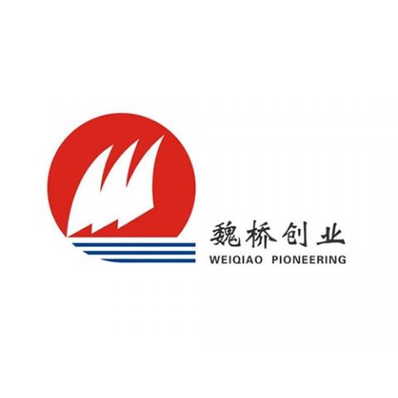









3. UNPRECEDENTED MINING INVESTMENTS
World-renowned companies are investing in Guinea
-

Slide 20











3. UNPRECEDENTED MINING INVESTMENTS
With world-renowned financial institutions
UNITED LOAN GUARANTEE (UFK GERMANY)

Slide 21
4. Beyond mining opportunities
Immediate opportunities

Slide 22
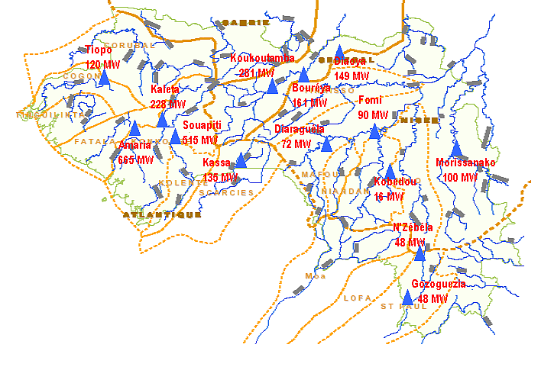
4. BEYOND MINING OPPORTUNITIES: MINING AND ENERGY
Guinea, as the water tower of West Africa, has a great potential for hydroelectric power that may help process some of the mining products, such as bauxite into alumina and supply the sub region.
Bauxite Zone
Gold Zone
Diamond Zone
Iron Zone

Slide 23
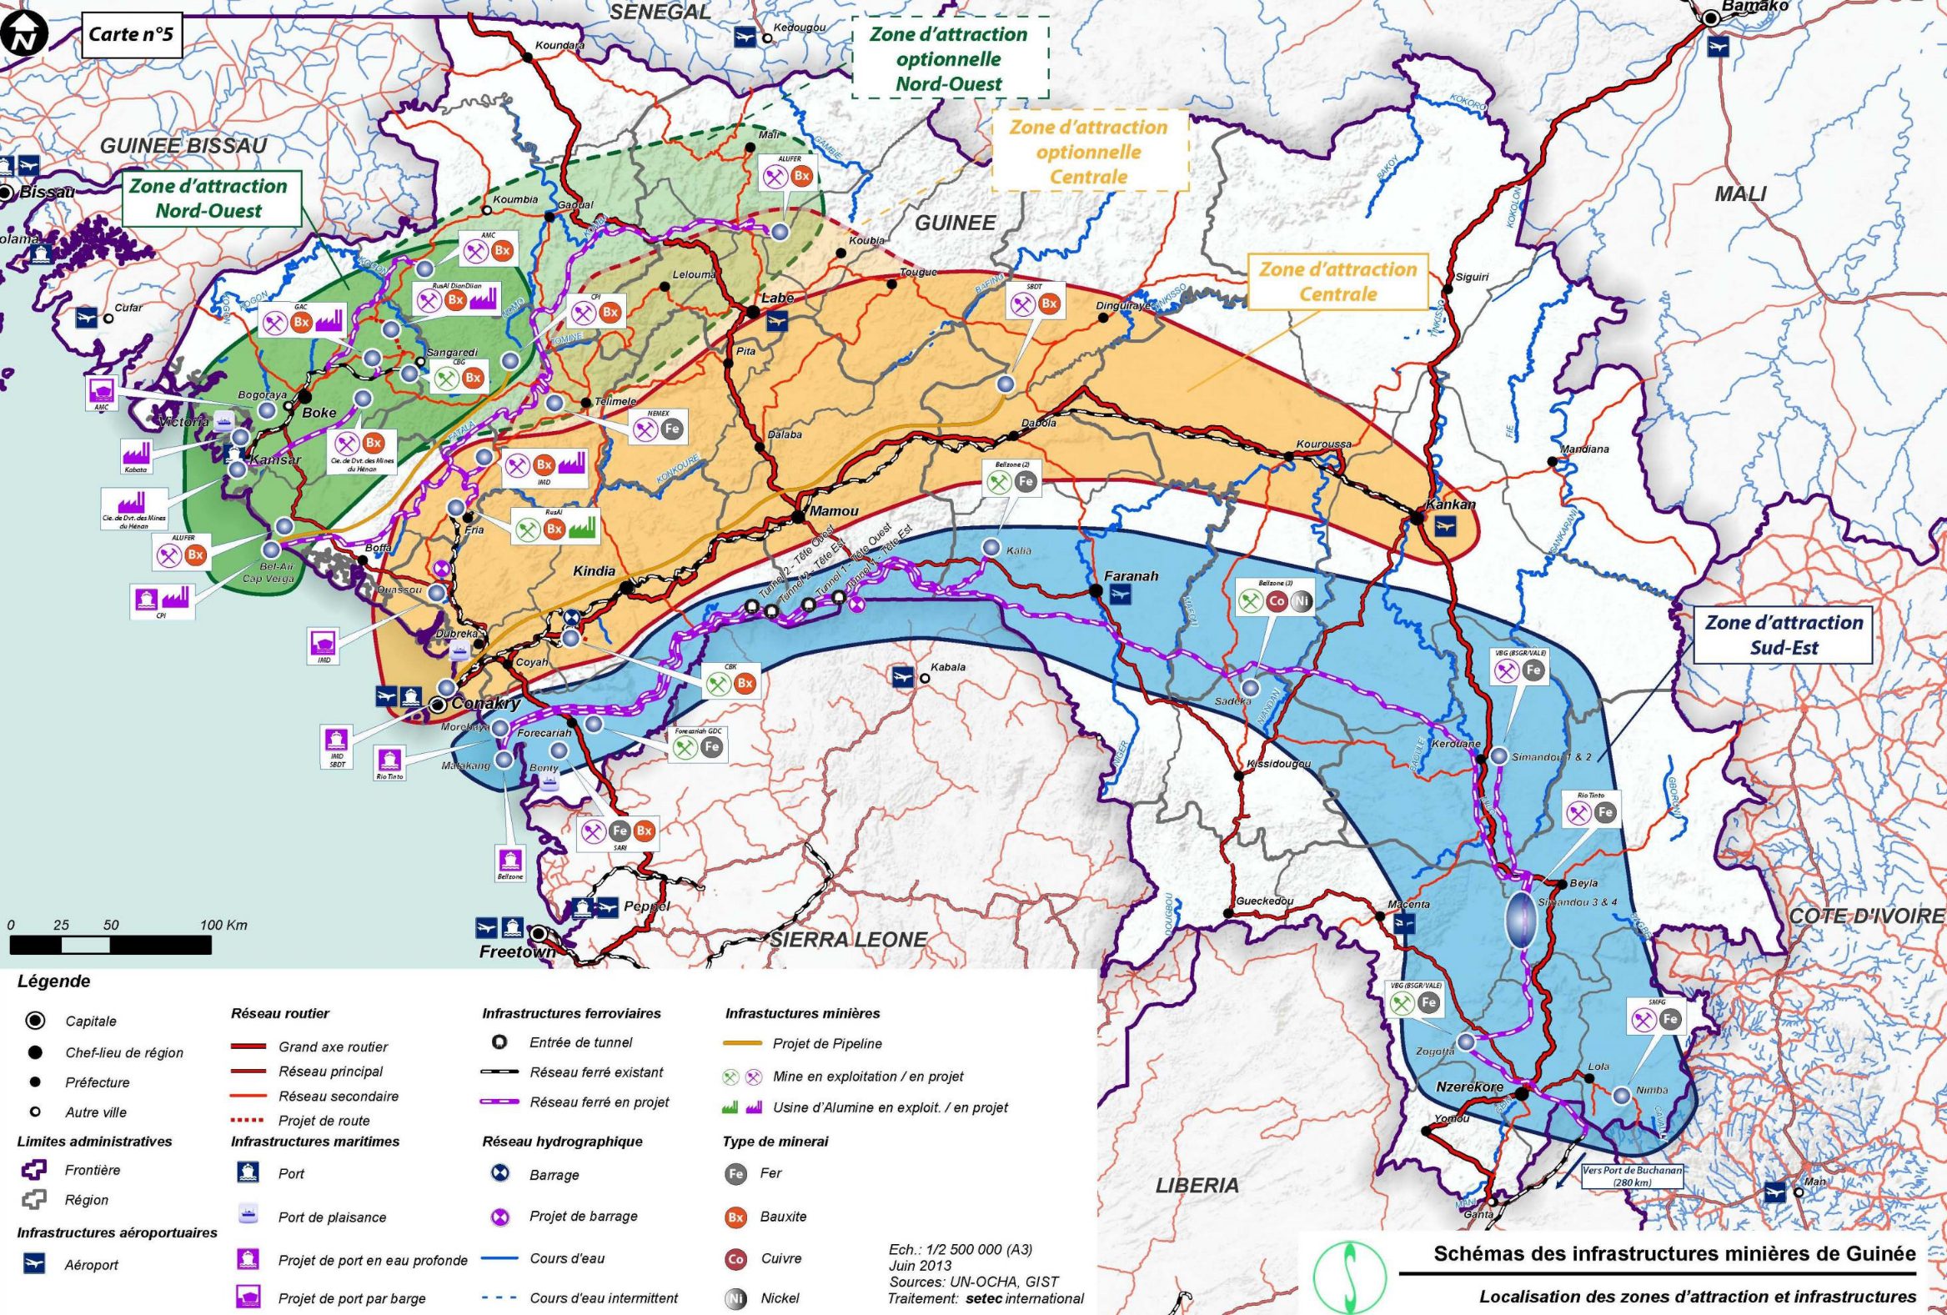
4. BEYOND MINING OPPORTUNITIES: MINING INFRASTRUCTURE

Slide 24
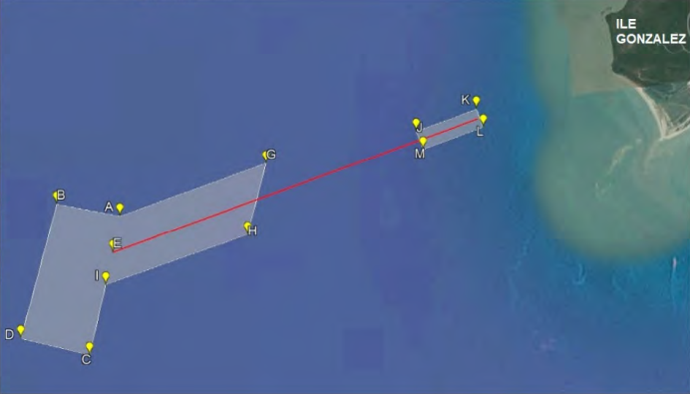
4. BEYOND MINING OPPORTUNITIES: GONZALEZ’S PORT PROJECT
The reasons for the project
Mining activities are booming along the northern corridor
Important tool for regional planning and infrastructure-sharing with regards of the development of mining activity
The principle of a deep-sea port is a major challenge for the competitiveness of Guinea’s mining industry,

Slide 25

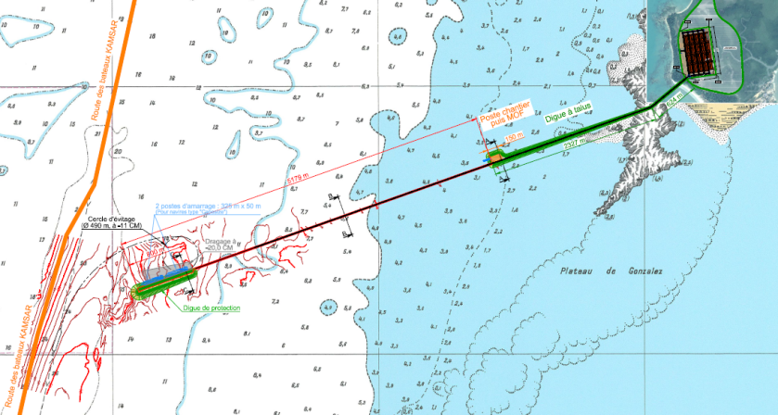
4. BEYOND MINING OPPORTUNITIES: GONZALEZ’S PORT PROJECT
Phase 1- Pre-feasibility
The main goal: to remove the uncertainties that could prevent the feasibility of the project
Define the natural conditions of the site:(Geology, bathymetry, Wind, Swell)
Phase 2- Feasibility
The objective of this second phase is to specify the project, its constraints and its cost.
Specify the natural conditions:
Deadlines for studies: 6 months

Slide 26
5.Strengthening the national economy
Building a robust economy

Slide 27
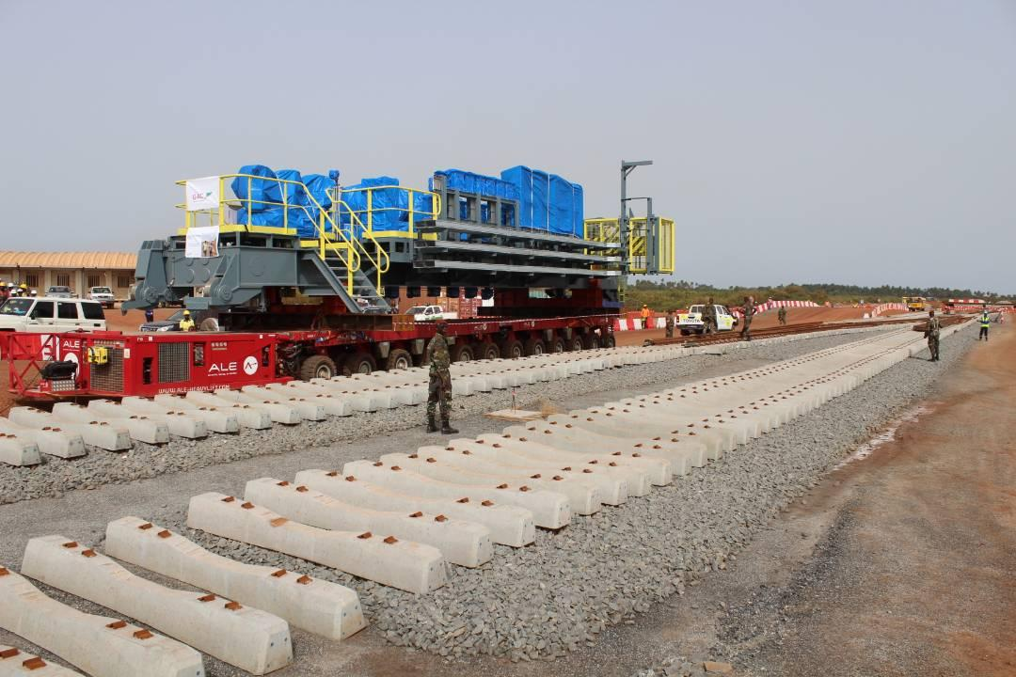
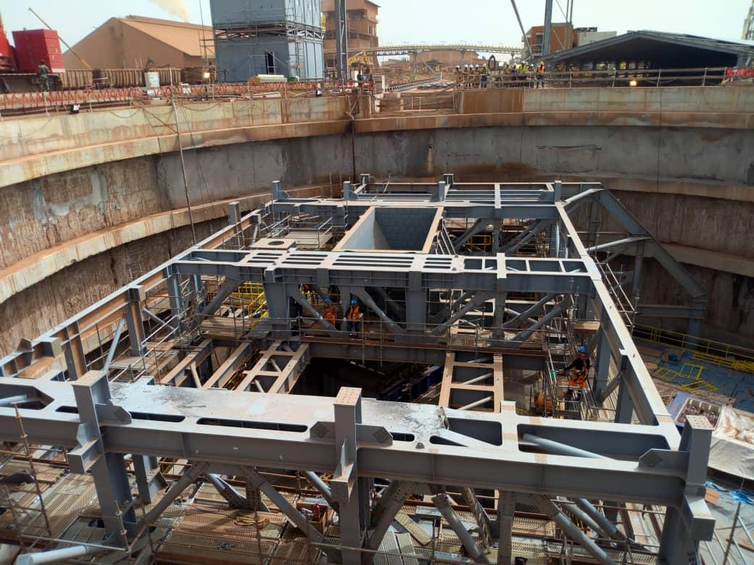
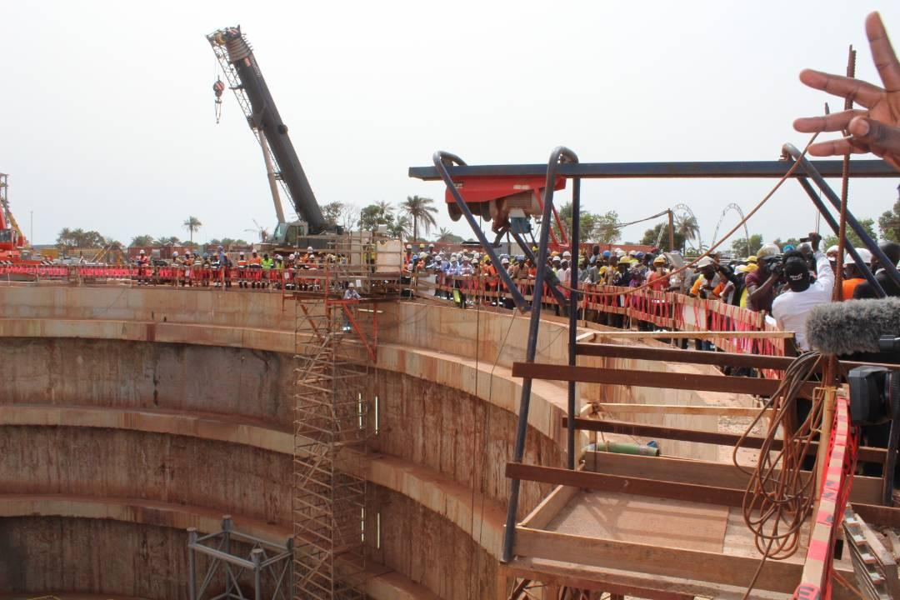
5. STRENGTHENING THE NATIONAL ECONOMY
The size of the Guinean economy has more than doubled over the past decade :
Guinea’s GDP grew from $4.74 billion USD in 2010 to $10.49 billion USD 2017;
State revenues from mining have more than triple: from less than $150 million USD in 2012 to close to $500 million USD in 2017 (EITI);
Mining projects have also helped boost many sectors of the economy including agriculture, transports, technology etc;
Guinea received $21bn USD pledges to fund it’s Five-year (2016-2020) development plan in November 2017

Slide 28
6. Remaining challenges
Taking up the challenges

Slide 29
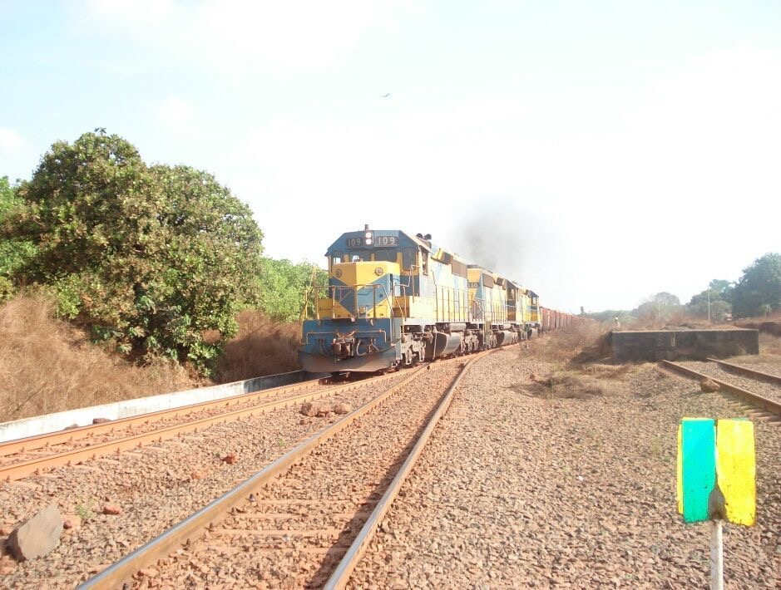
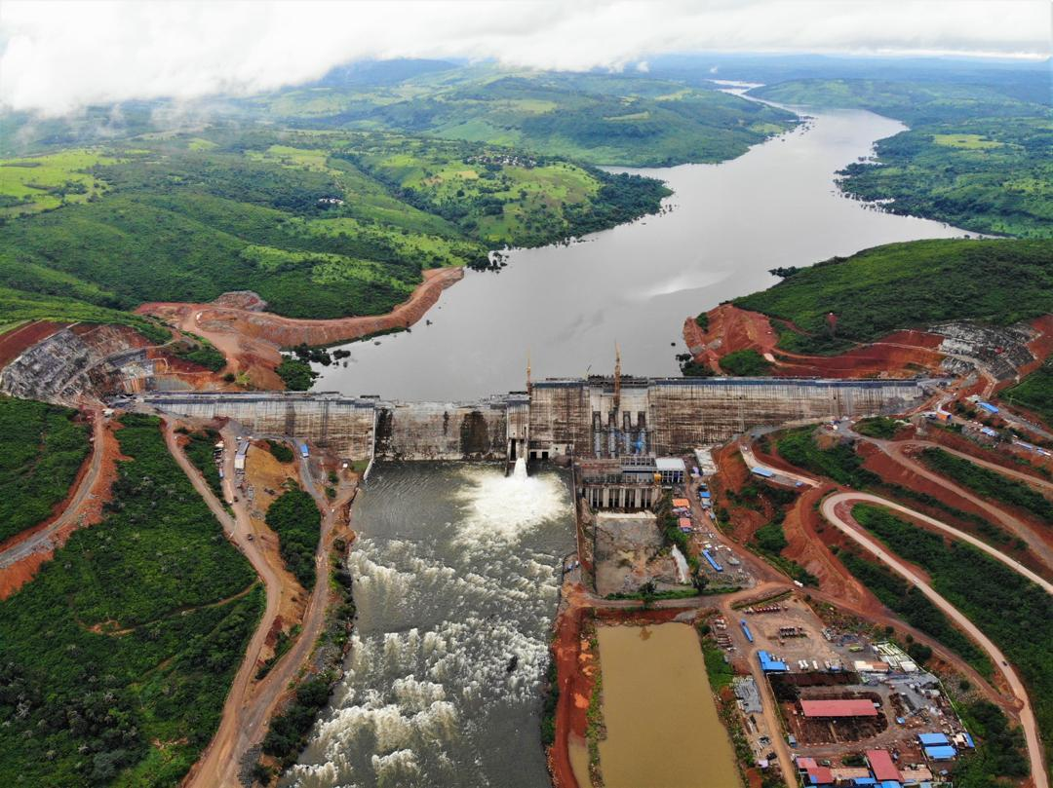
6. REMAINING CHALLENGES
Infrastructure (Energy and Transport): to reduce the cost of mining projects.
Capacity building: to support, manage and control projects;
Impact of mining projects: economic, social and environmental;
Local transformation of minerals into higher value products;
Geological Survey: to increase knowledge, diversify the economy and make a better use of the geographical space;

Slide 30

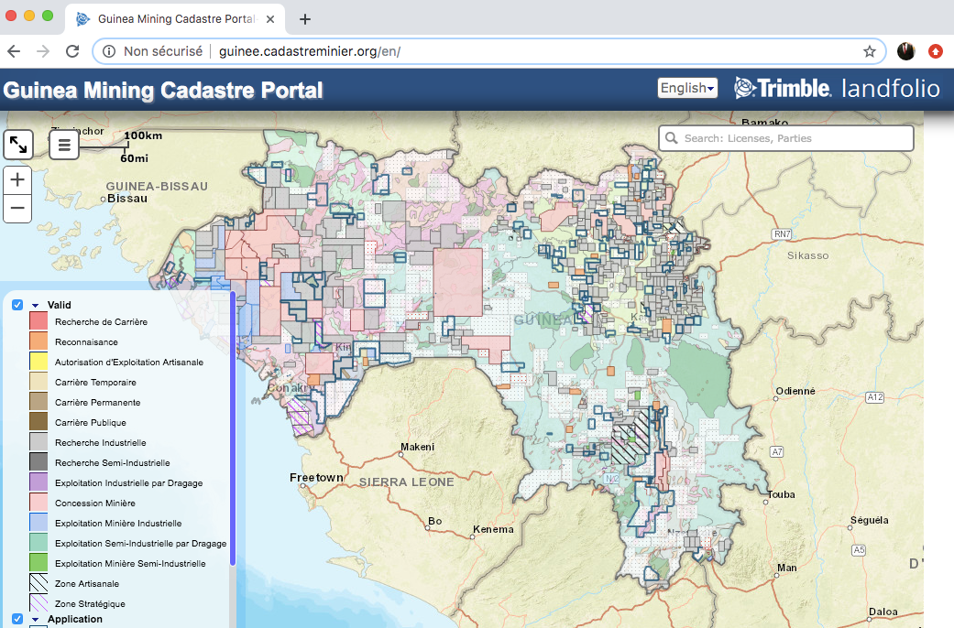
VISIT US ONLINE
Ministry of Mines and Geology
www.mines.gov.gn
One Stop Shop
www.licences.mines.gov.gn
Guinea Mining Cadastre Portal
www.guinea.miningcadastre.org
THANK YOU

