Slide 1
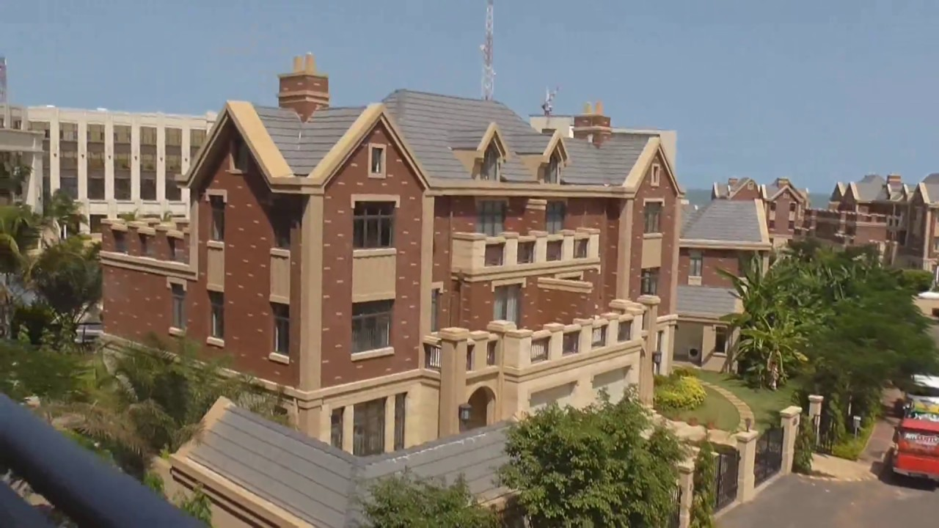
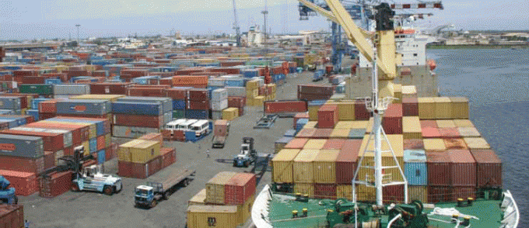

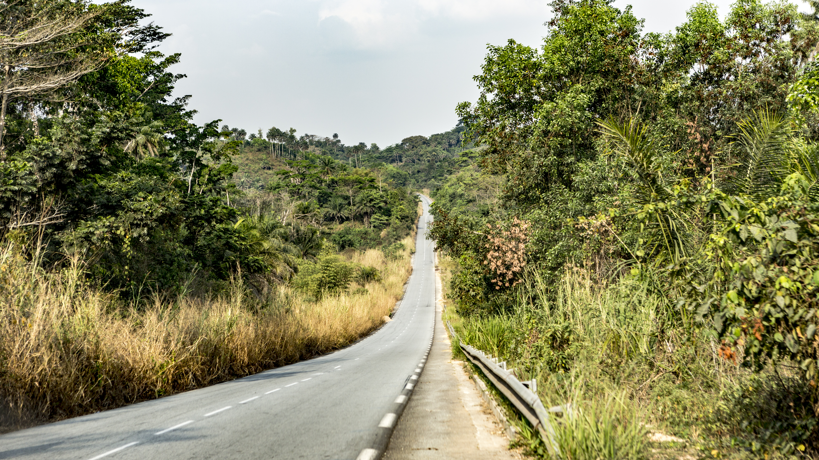
Invest in infrastructures
Ensure the economic development of the country by multiplying large works

Slide 2
Plan
  General presentation
  Maritime transport
  Land transport
  Air transport
  Real estate infrastructure
  Investment opportunities

Slide 3
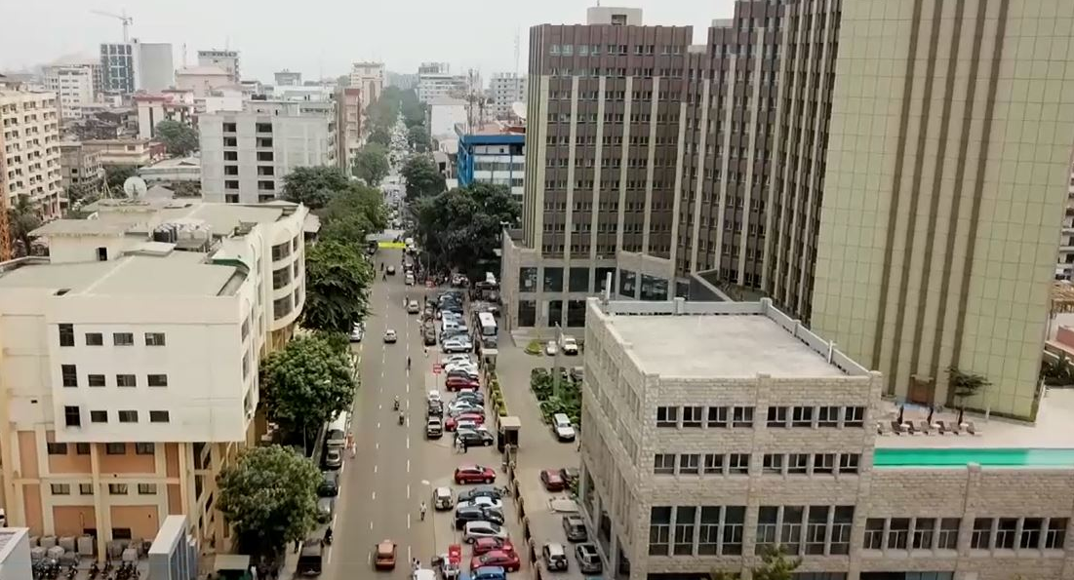
General presentation
3

Slide 4
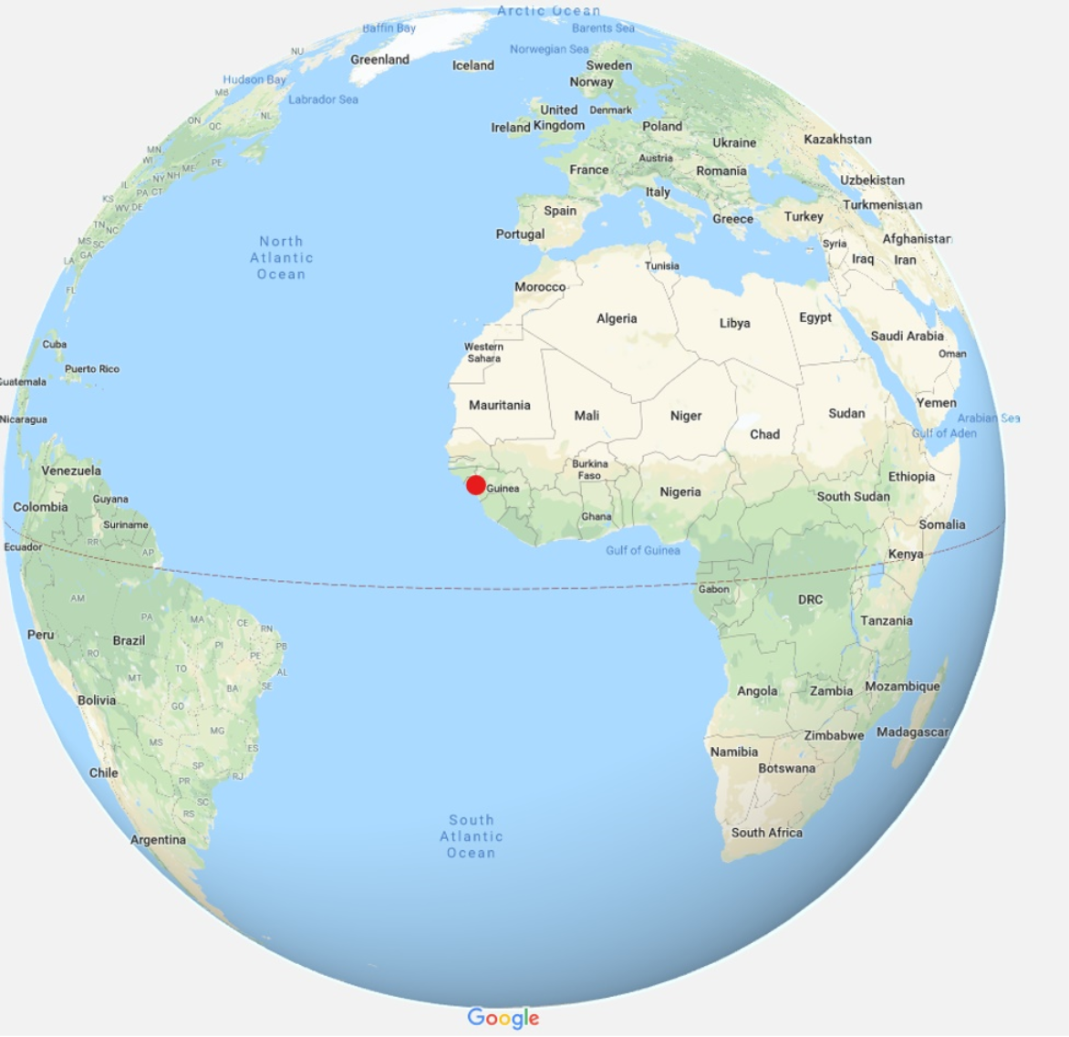
General presentation
Area: 245,857 Km²
Population: 12 million inhabitants
One of the highest growth rates in the world:
9.9% on average since 2016 (IMF)
Gain of 27 ranks in the World Bank's Doing Business in 7 years
Mobilization of more than 21 billion USD at
the PNDES Advisory Group for 2016-2020
Guinea-China framework agreement: 20 billion USD over 20 years for infrastructure financing

Slide 5
Legal and institutional framework
Strengthening the legal framework with the adoption of a:
Code of Local Communities in 2017
Construction and Housing Code in 2016
Investment Code in 2015
Guinea's National Housing Policy (Vision Habitat 2021) developed in 2012
Five-year plan (CNT Act No. 007 of 7 June 2012)
National Economic and Social Development Plan (PNDES 2016-2020)

Slide 6
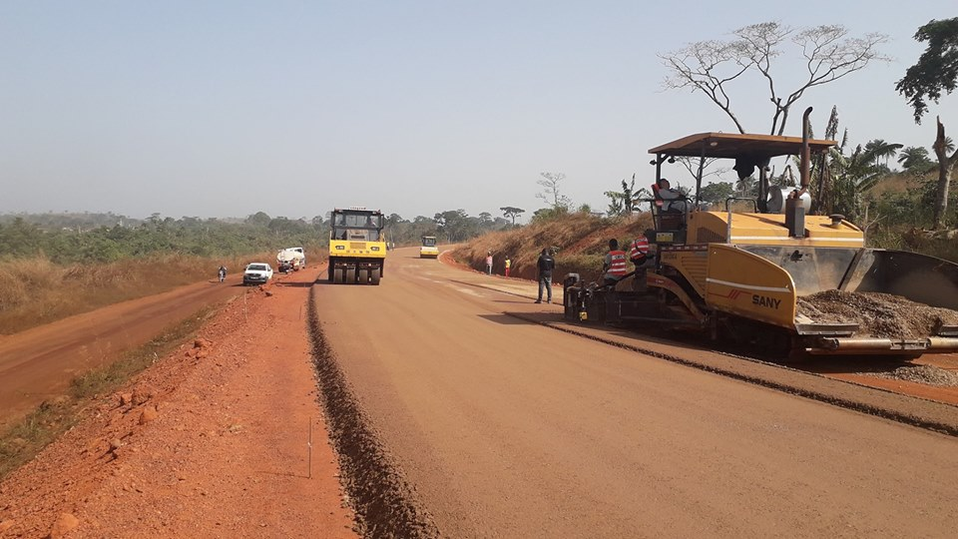
Ground transport

Slide 7
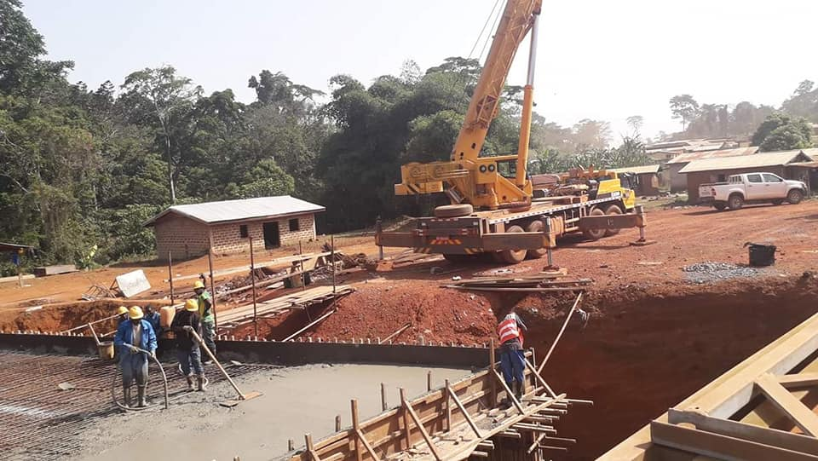
Ground transport, a mutation in progress
45,301 km of existing roads
Construction or rehabilitation of 1,011 km of national roads and construction of 5 bridges
Maintenance of 4,000 km of degraded national roads
Improvement of 5,000 km of prefectoral and community roads
Construction of 200 km of urban roads in Conakry and some inland cities
Rehabilitation of 4 weighing stations.
Rehabilitation and sanitation of Conakry roads under way
Several structural reforms accompanied by achievements
of unprecedented importance in the history of
the Republic of Guinea

Slide 8
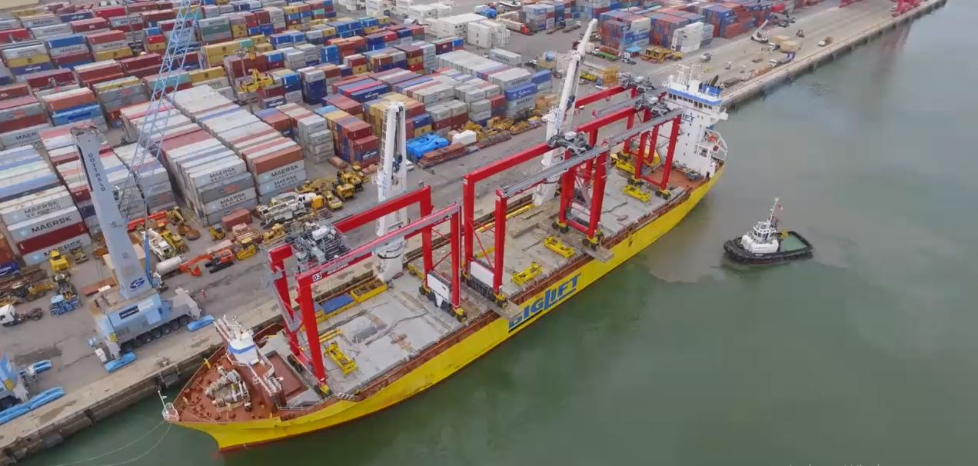
Maritime transport

Slide 9
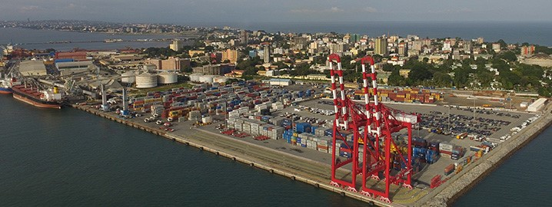
Modernization of the Autonomous Port of Conakry
Expansion of the Autonomous Port of Conakry by 88.7 hectares
Inauguration in 2014 of the 12th berth (terminal) 13 meters deep, and acquisition of several modern equipment
Construction of a 4 km long penetrating road and parking areas with a capacity of
600 trucks
1,185 ships received in 2018 versus 694 in 2010.
Increase in traffic from 6,876,441 tons in 2010 to 10,700,000 tons in 2018 (56%)

Slide 10
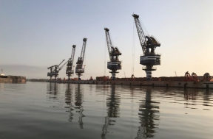
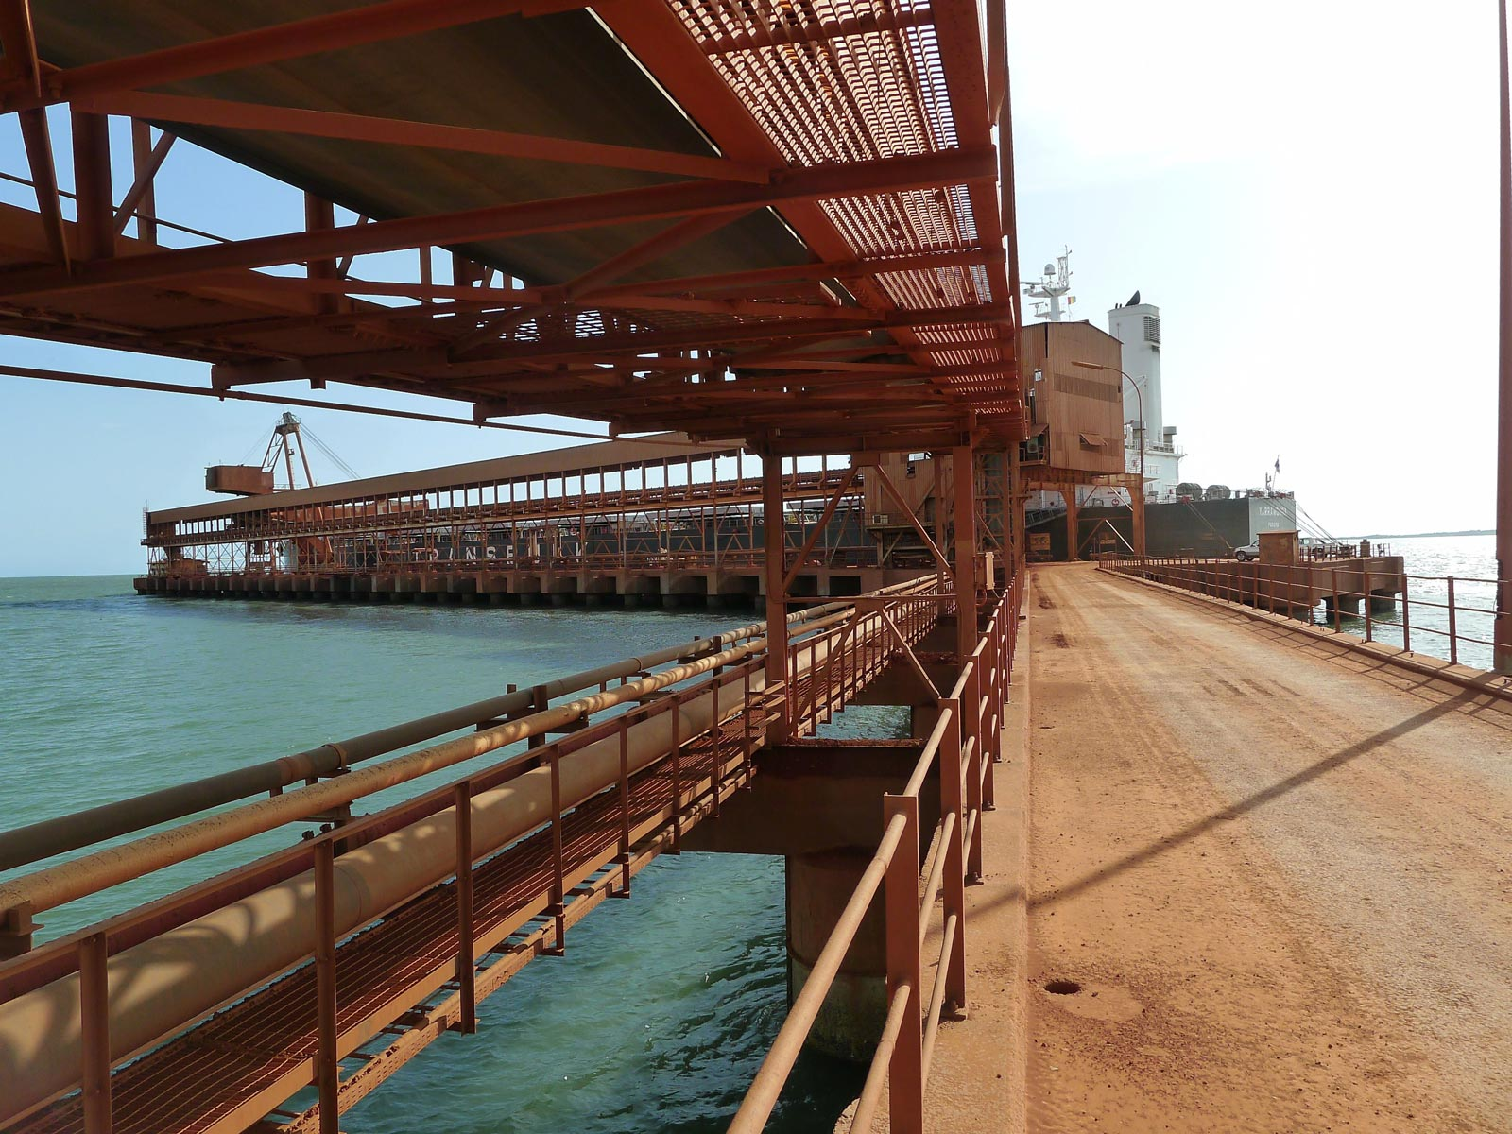
Port infrastructure at the heart of the economy
Construction in 2014 of the ports of Katougouma
(70 ha) and Dapilon (300 ha) in the Boké area,
making it possible to export 2/3 of current bauxite production in Guinea
Opening of the port of Taressa operated by Rusal
in June 2018 with an annual capacity of 6Mt/year
Completion in 2018 of the Bel Air port operated by Alufer, completed in 2018 (production target of
5 to 7 Mt/year)
Development of the port of Kamsar (100 ha) located
in the direct mouth of the Rio Nunez and divided into two sites operated by CBG and GAC (14 Mt/year)
Construction in progress of the ports of Benty and Konta
The area of Kokaya on the Fatala, will house the evacuation infrastructures of several bauxite mining companies.

Slide 11
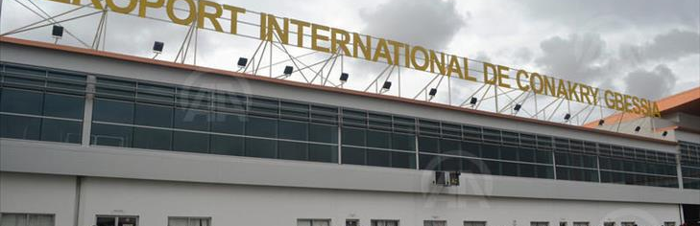
Air transport

Slide 12
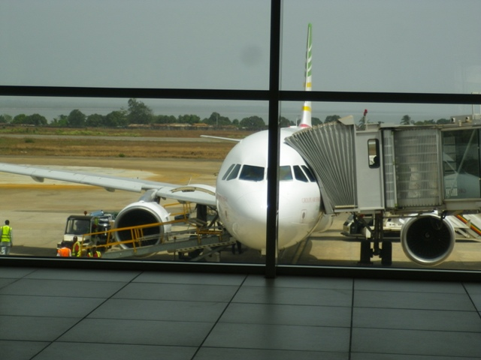
Aerial Infrastructure
1 International airport in Conakry and 3 regional airports in Kankan, Labé and N’Zérékoré
5 secondary airports in Boké, Faranah, Fria, Kissidougou, Macenta, Sambailo and Siguiri
6 aerodromes built and operated by mining companies in Banankoro Léro, Kamsar, Sangarédi, Beyla, and Kignéro
Project to build an international airport in Maférinya (70 km from Conakry)
Rehabilitation of the air transport national company "Guinea Airlines"
Modernization of Gbessia International Airport:
Reception capacity of 1,500,000 people in 2018 versus 300,000 people in 2010;
Reception of 12 airlines in 2019 versus 9 in 2010
527,000 visitors received in 2018 compared to 245,000 in 2010

Slide 13
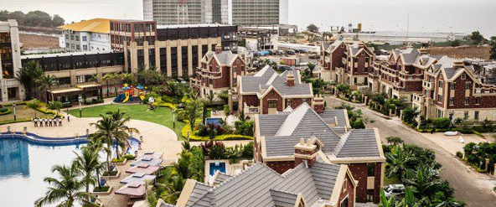
Real estate infrastructure

Slide 14
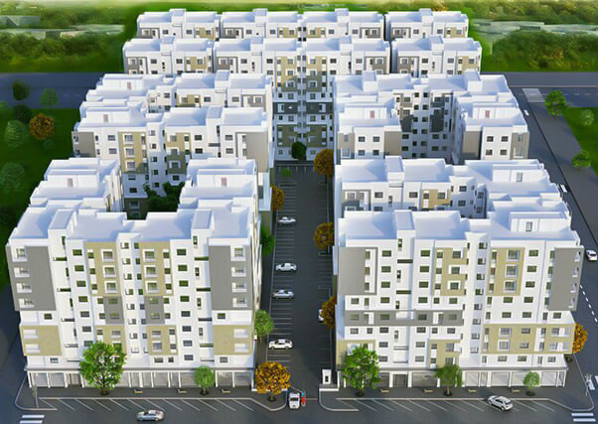
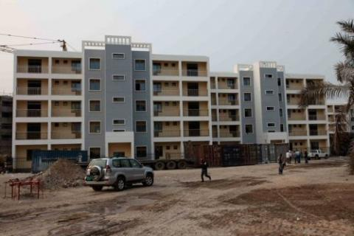
Housing
Launch of the presidential initiative "a roof for every Guinean"
Housing deficit estimated at 500,000 units in Guinea
Annual housing demand estimated at 47,000 units
Growth in urbanization in the Conakry metropolitan region estimated at 6.3%/year
Identification of 33,754 ha of land reserves intended mainly for the construction of
social housing (2018)

Slide 15
Development of urban centers
Kassonyah City Project: Signing of an agreement in September 2016 between SONAPI and Power China Engineer for the construction of 5,000 housing units in Kassonyah (Coyah Prefecture) and related infrastructure (motorway, administrative and financial district, circular road, two hotels).
New town of Kobaya: 650 hectares on a low beach area. Program to build 15,000 social housing units and related infrastructure (a national center for the secondary administration of green and recreational spaces).
Customs City Project: High-quality residential program extending over 2 hectares composed of buildings (R+7) with 761 apartments with modern finishes and contemporary design
Police City Project: Construction of 1,891 housing units, including 1,486 social housing units and local facilities (shops, schools, green and leisure areas).

Slide 16
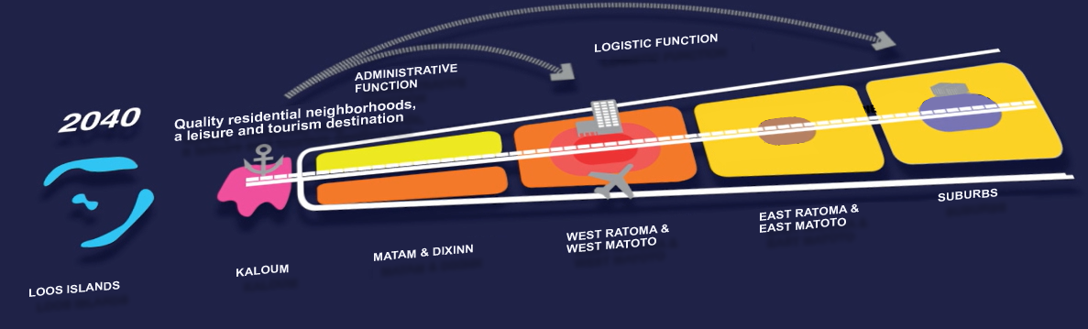
Greater Conakry 2040 Project
The Kaloum and Loos Islands redevelopment project was initiated by the Government to revitalize the capital region.
It aims to reposition Kaloum by optimizing its picturesque waterfront and revitalizing its existing buildings, infrastructure and heritage and transforming the archipelago of the Loos Islands into "Celebration Islands" with venues for events, festivals and culture.

Slide 17
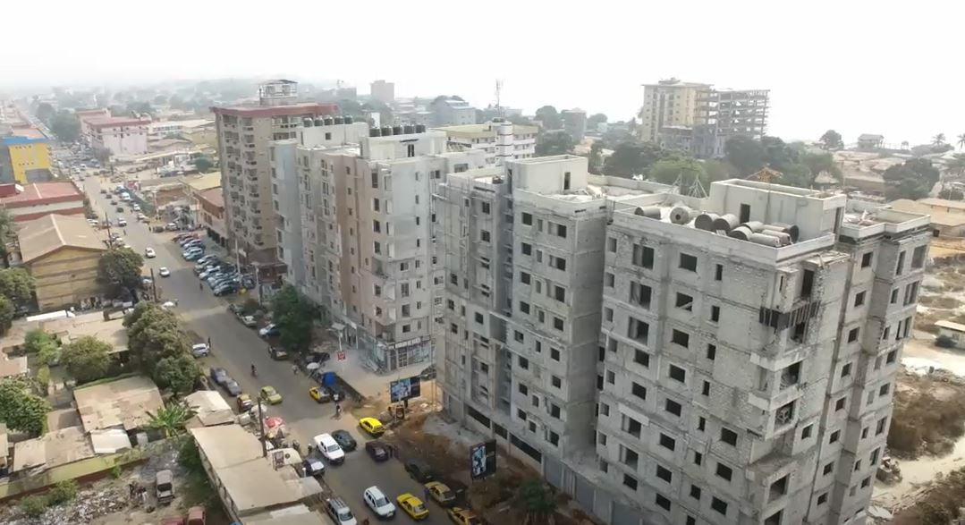
Investment opportunities
17

Slide 18
Investment opportunities
NO. | PROJECT | COST
1 | Development of the RN27-RN30 national roads (Labé, Tougué, Dinguiraye, Siguiri) | 377 million USD
2 | Construction and equipment of the National Youth Palace | 88 million USD
3 | Construction and rehabilitation of the Kankan-Kérouané-Beyla road | 231 million USD
4 | Rehabilitation of the universities of Sonfonia, Labé, Kankan and N'Zérékoré | 350 million USD
5 | Construction and rehabilitation of the Labé-Mali-Kédougou road (185km) | 291.2 million USD
6 | Development of 88.7 ha in the eastern zone of the Port of Conakry | 774 million USD

Slide 19
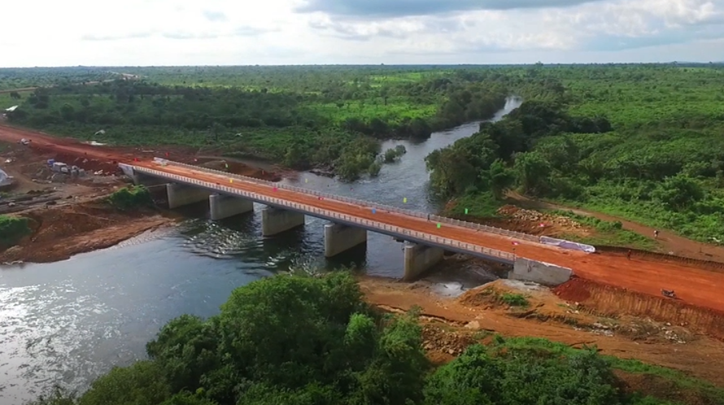
Thank you for your attention
Insert Image
www.invest.gov.gn
www.mtp.gov.gn

