Slide 1
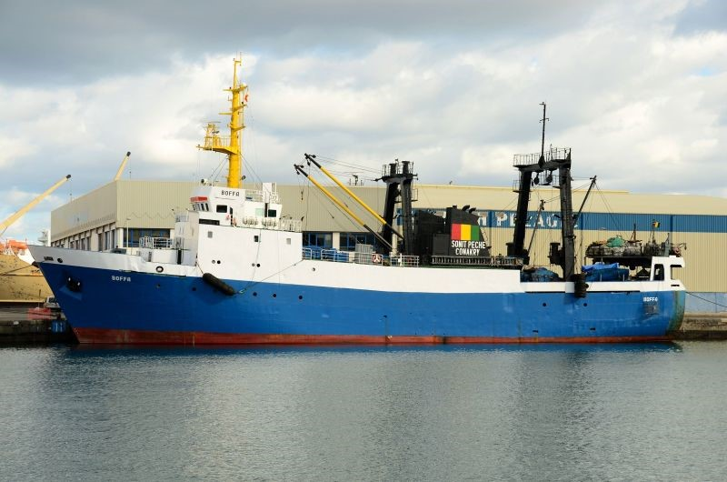

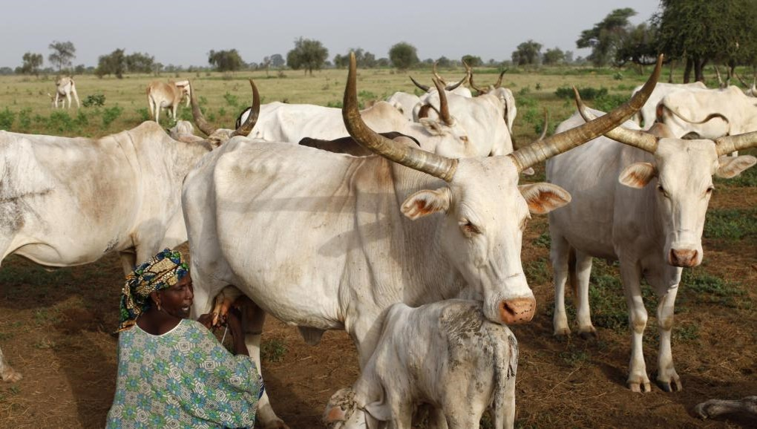
Invest in livestock and fishing
Rural development at the heart of food self-sufficiency

Slide 2
Plan
  General presentation
  Abundant animal and fisheries resources
  Reforms underway
  Investment opportunities

Slide 3
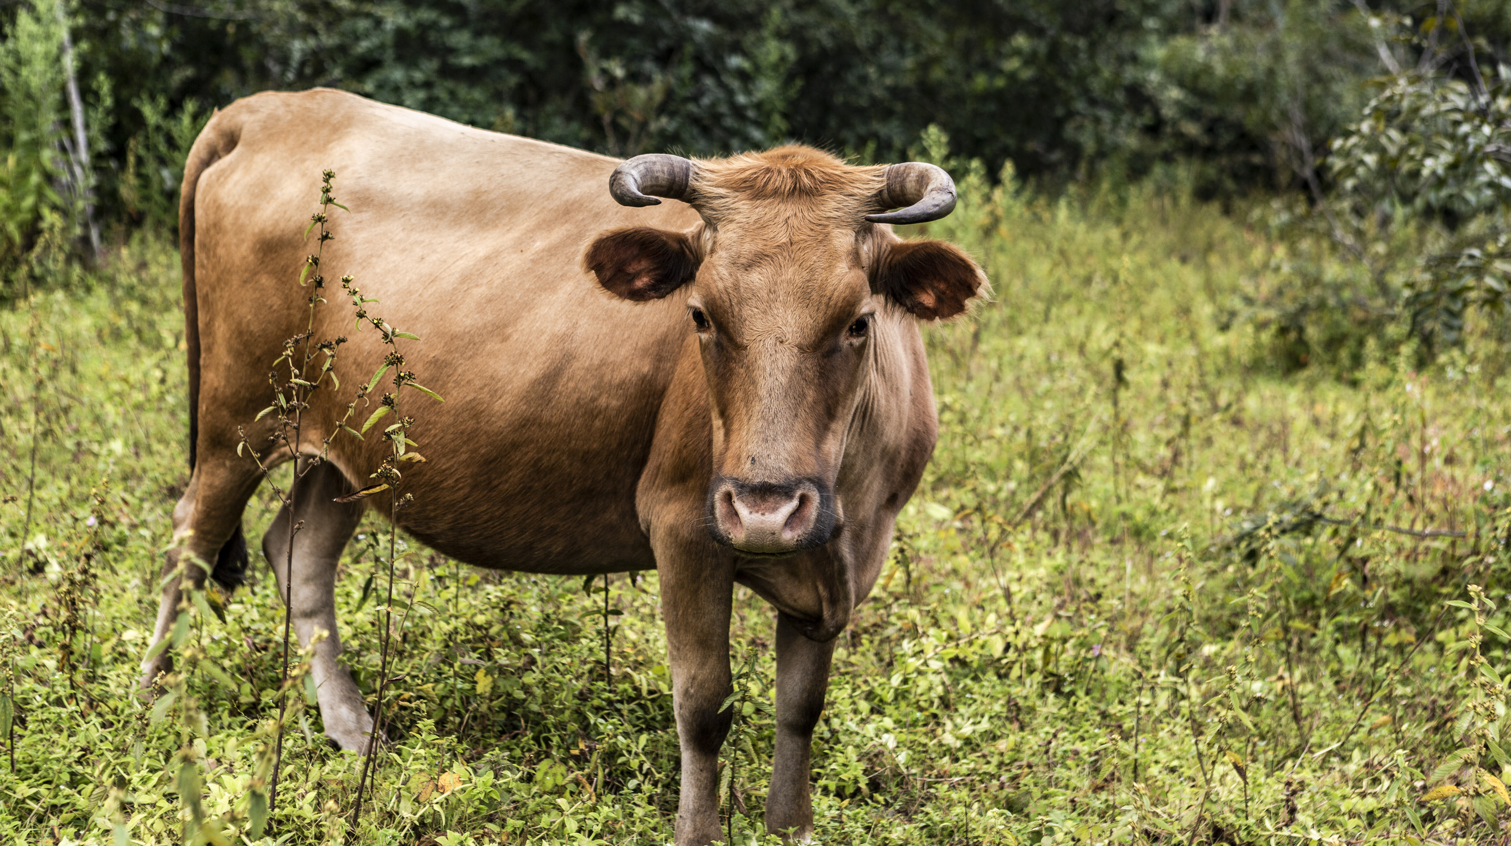
General presentation
3

Slide 4
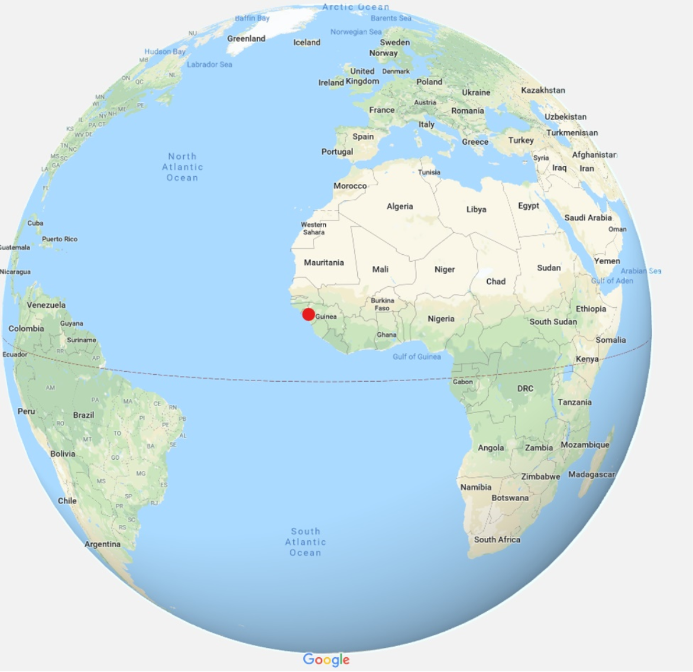
General presentation
Area: 245,857 Km²
Population: 12 million inhabitants
One of the highest growth rates in the world:
9.9% on average since 2016 (IMF)
Gain of 27 ranks in the World Bank's Doing Business in 7 years
Mobilization of more than 21 billion USD at
the PNDES Advisory Group for 2016-2020
Guinea-China framework agreement: 20 billion USD over 20 years for infrastructure financing

Slide 5
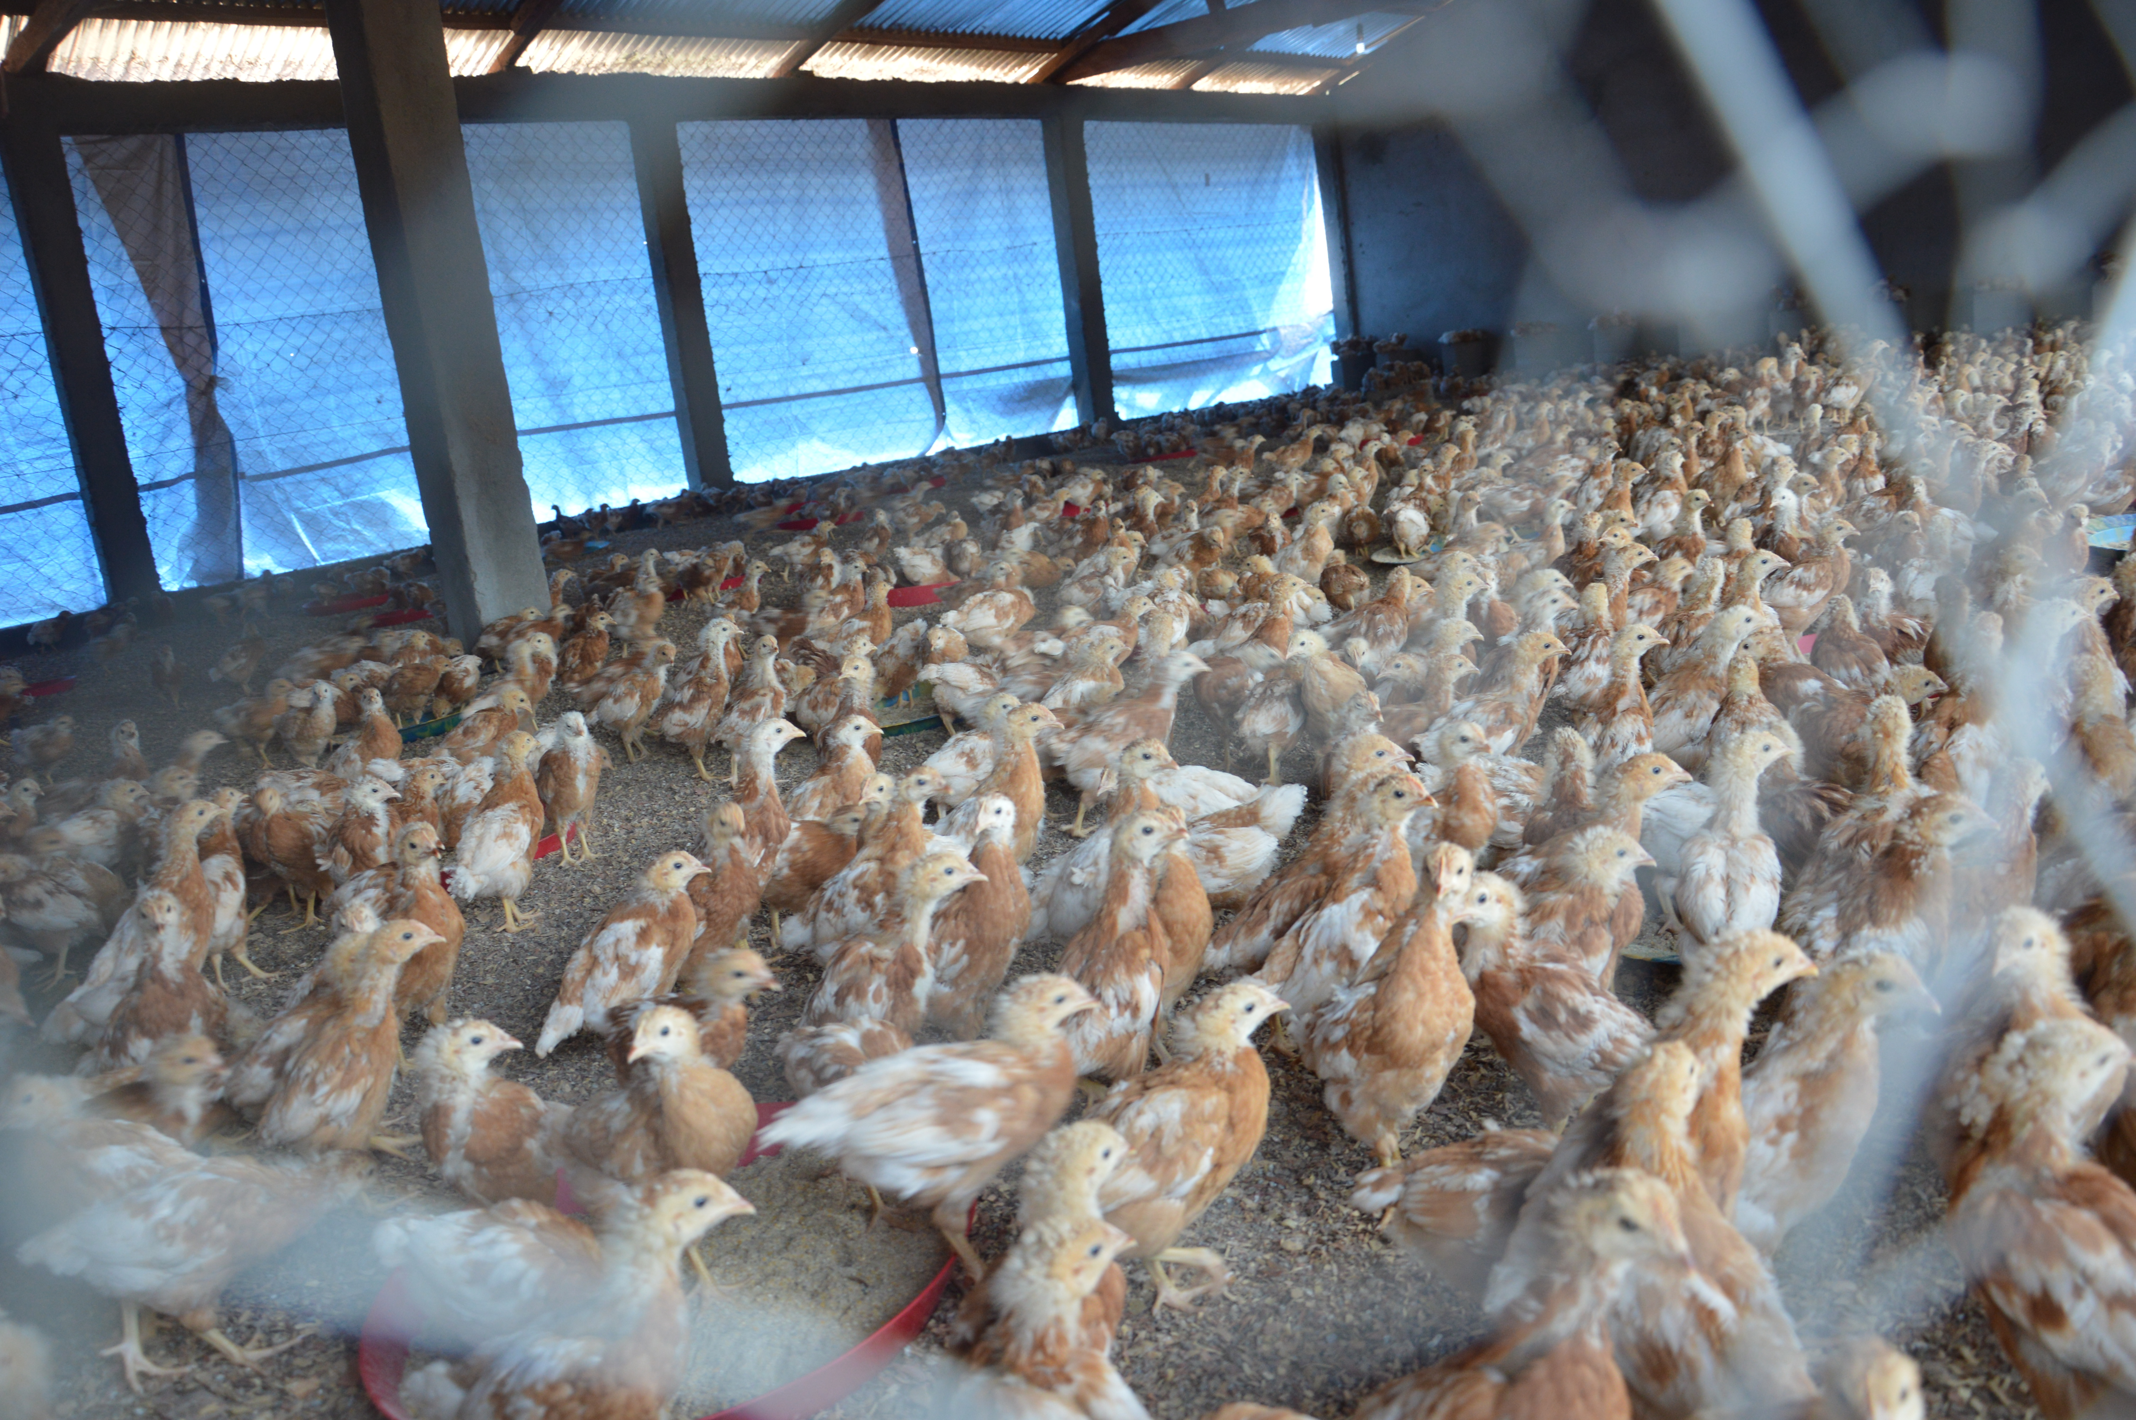
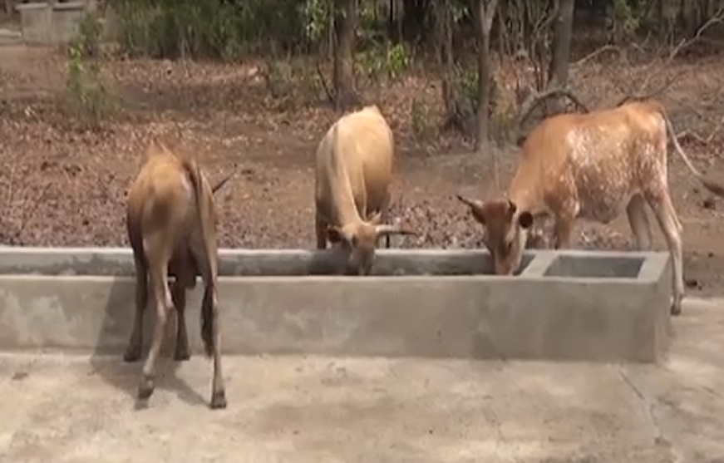
Abundant animal and fisheries resources
Livestock breeding
A country with a strong pastoral tradition (300,000 herders)
A diversity of agro-ecological conditions
Presence of rich and varied natural pastures (70,000 km²)
Water resources consisting of several river basins (1,165 waterways)
Availability of agricultural and agro-industrial by-products for livestock feed
A livestock (cattle, sheep and goats) made up of species and breeds characterized by their hardiness, their ability to adapt to their environment and especially their resistance to trypanosomiasis

Slide 6
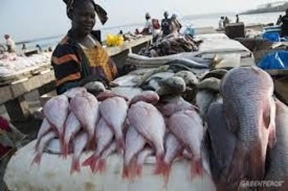
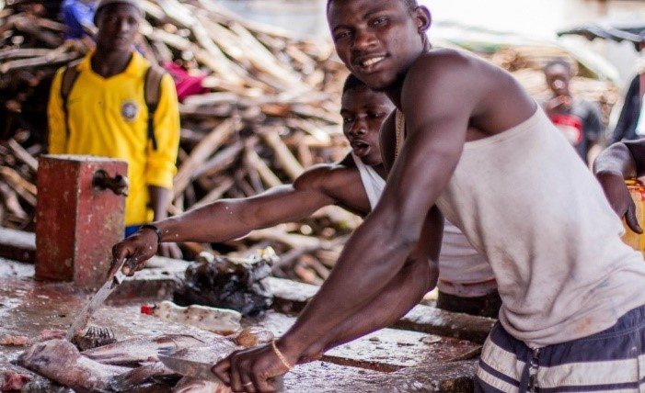
Abundant animal and fisheries resources
Fishing
330 km of maritime coast
Hydrographic network comprising 23 river basins, including 9 national and 14 transboundary
Estimated fishing potential between 150,000 and 250,000 tons of fish/year
Aquaculture potential estimated at 520,000 ha
140,000 ha of land in mangrove and back mangrove swamps
200,000 ha of river alluvial plains

Slide 7
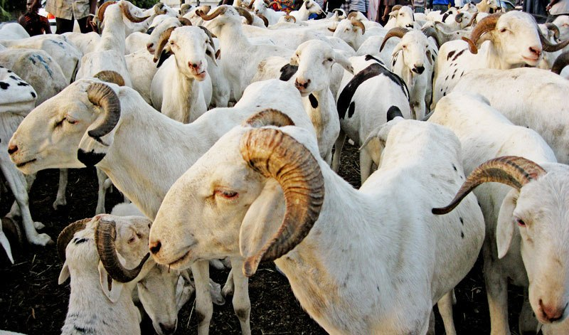
Reforms underway
7

Slide 8
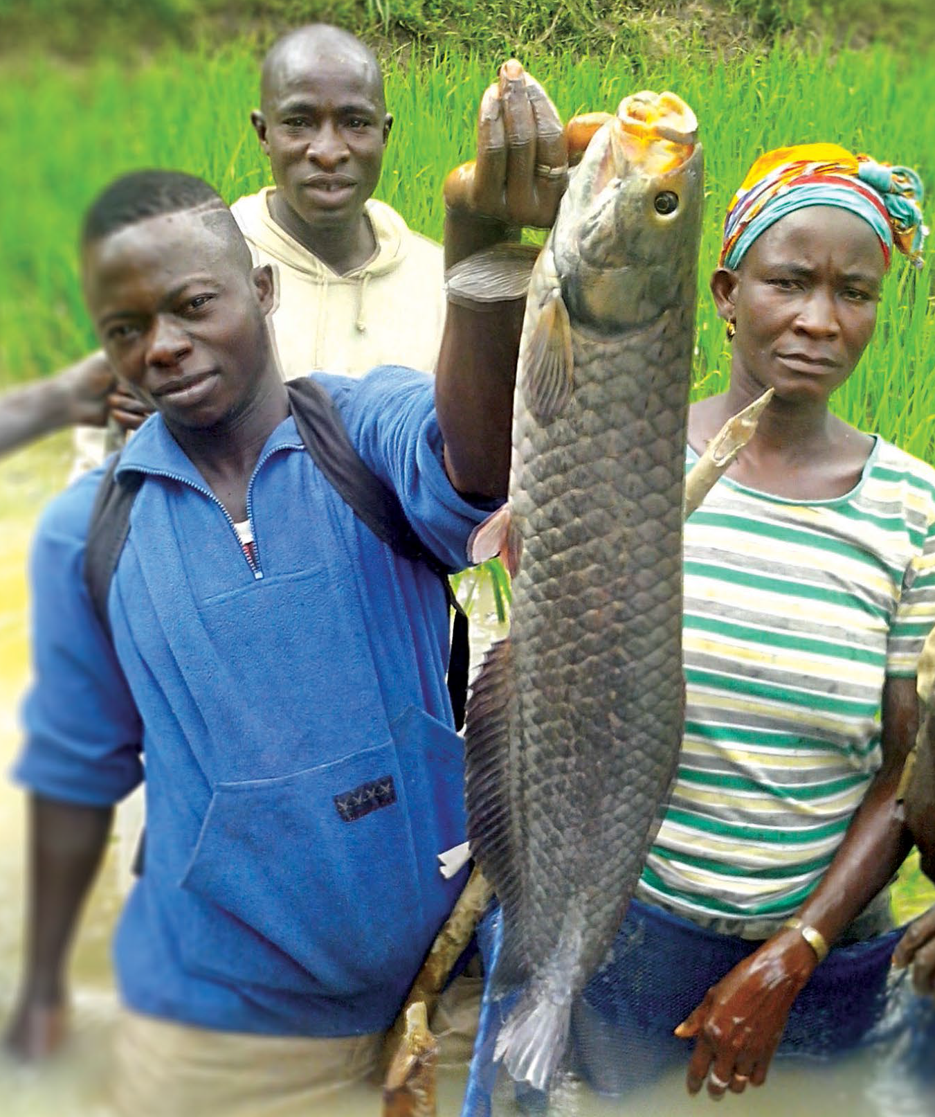
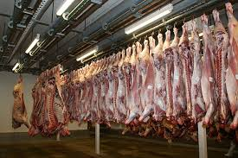
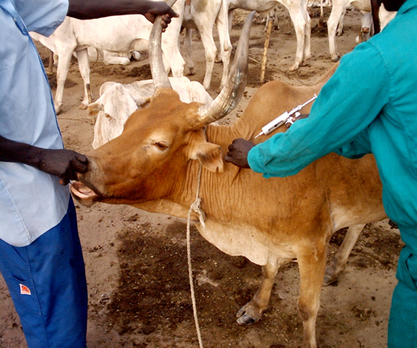
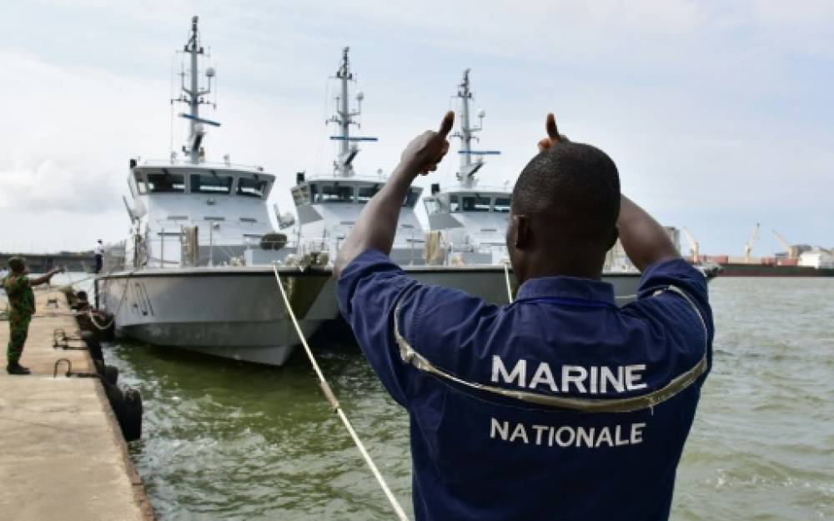
Ambitious reforms
Marketing & Food
Animal health & public
Animal production
Maritime Protection
1 regional livestock market
4 prefectural cattle markets
4 improved slaughter areas
10 pastoral boreholes equipped with solar pumping systems in the cattle breeding regions of Gaoual and Dinguiraye
Implementation of a master plan for the development and management of pastoral areas including 124 sites
Rehabilitation of the veterinary diagnostic laboratory (USAID & FAO support)
Construction of 4 regional laboratories in progress
Renovation and equipment of the Livestock Farming Support and Demonstration centers in Boké and Famoïla
Construction in Kouria of a laboratory meeting international standards (support of the World Bank REDISSE Project).
Annual growth of livestock by 16.25% between 2014 and 2018
Increase of fish farming with an annual output from 100 tons of fish in 2010 to 2,400 tons of fish in 2018.
Growth in exports of fresh fish (284%), smoked fish (163.5%) and dried fish (153.3%) between 2012 and 2018
Revision of the Maritime Fisheries Code
Revision of the Inland Fisheries Code
Adoption of a new Aquaculture Code
Creation of a maritime prefecture to board offending vessels
Introduction of secure documents for fishing licenses

Slide 9
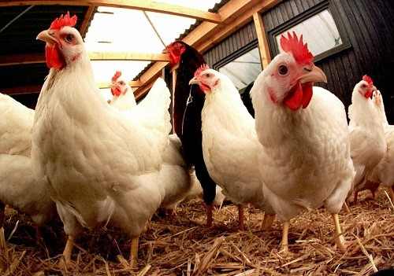
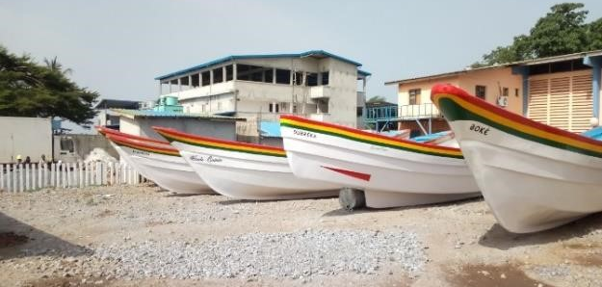
Presidential Initiatives for Rural Development
Fishing and aquaculture
Livestock breeding
Support Project for the Development of Artisanal Fishing, which will create 19,500 jobs in 3 years through the shipyard for the construction of fiberglass boats equipped with outboard motors
Project for the development of shrimp farming in the framework of public-private partnerships (Japanese collaboration)
Construction of fish farming technical centers in the four natural regions: (in PPP with Israelis)
Start in March 2019 of the Commercial and Family Fish Farming Project in 17 prefectures in collaboration with the French Development Agency
Fish farming on the high seas. This project was initiated in 2018 for the production of marine species in floating cages for export and sale on the national market
Establishment of a supply center for fishing inputs
Construction of fish processing units meeting quality standards;
Establishment of manufacturing units for packaging materials
Stocking ponds/pools/reservoirs with fish through Guinea - Côte d’Ivoire cooperation.
Artificial bovine insemination by the introduction of seed of exotic breeds (Guinea-Moroccan cooperation). 10,000 cows will be inseminated in 2019.
Introduction of 445 exotic purebred pig spawners from Côte d'Ivoire to combat the effects of inbreeding
Introduction of 300 Maradi goats from Niger to improve the productivity of goat farms in 21 prefectures
Introduction of 5,000 Wassachiè hens from Mali in support of 120 general interest groups of young people and women.
Program to supply day-old chicks from Côte d'Ivoire to poultry farmers in Forest Guinea.
Feed Improvement Program: consists in the construction of two feed plants through the private sector.

Slide 10
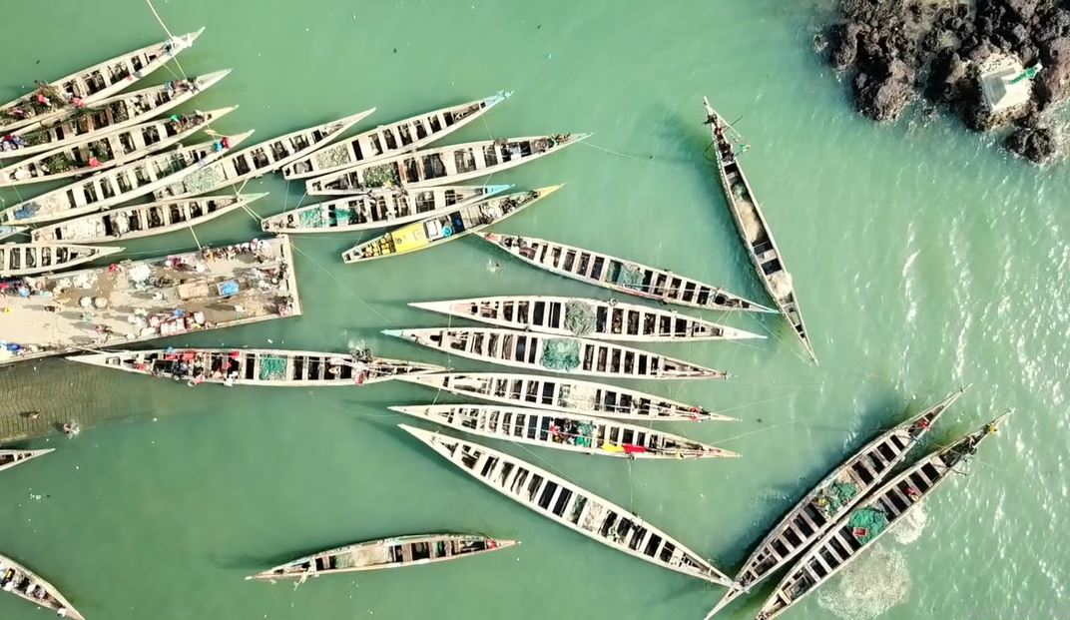
Investment opportunities
10

Slide 11
Investment opportunities
NO. | PROJECT | COST
1 | Development of intensive meat and dairy production | 8 million USD
2 | Creation of a poultry and egg production complex in Upper Guinea | 12.7 million USD

Slide 12
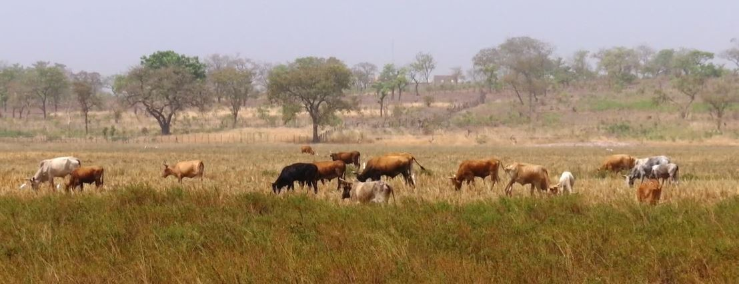
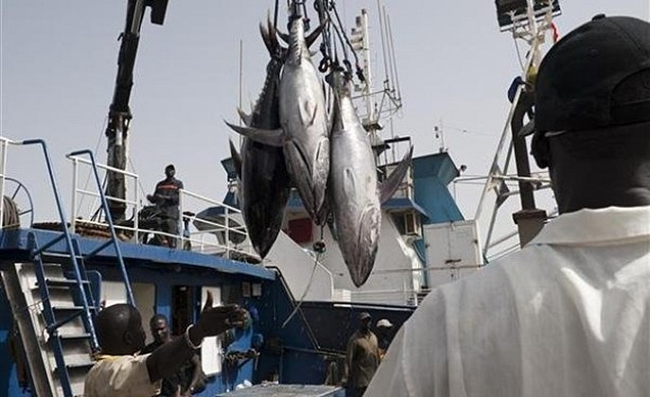
Thank you for your attention
Insert Image
www.invest.gov.gn

